Slide 1
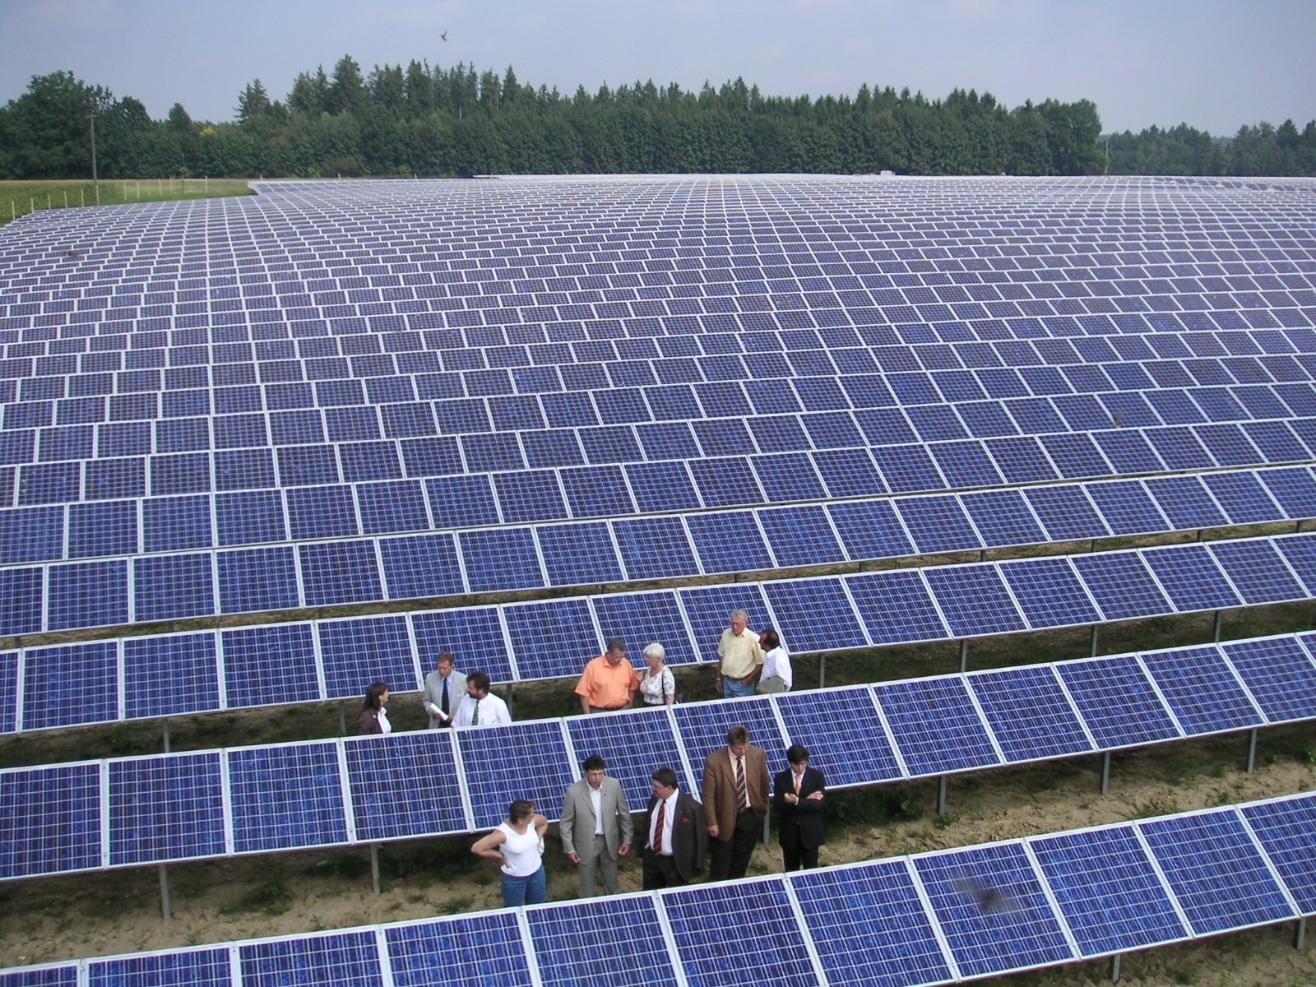
Renewable Energy
“The use of solar energy has not been opened up because the oil industry does not own the sun.”
- Ralph Nader

Slide 2
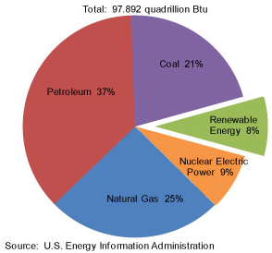
Nonrenewable Energy
Nonrenewable energy, including fossil fuels and nuclear power, make up the vast majority of the U.S. energy portfolio.
In the long-term, there are two major issues with this reliance on nonrenewable energy:
Dwindling supplies.
Environmental pollution.

Slide 3
Dwindling Supplies
Nonrenewable resources, by definition, are finite and will eventually be used up.
Most of the easily recoverable sources of coal, oil, and natural gas have already been tapped.
As supplies of these resources tighten, or they become more expensive to extract, price will increase.

Slide 4
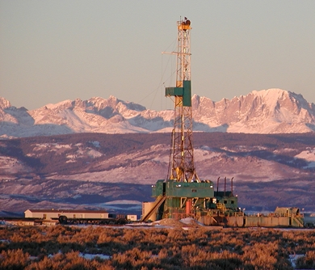
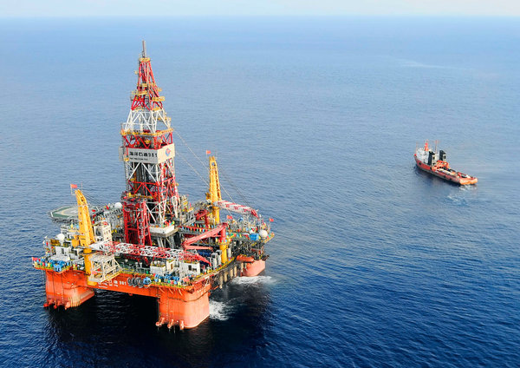
Deep-ocean drilling of oil and hydraulic fracturing of natural gas are examples of resource extraction that would not have been economically viable in the past.

Slide 5
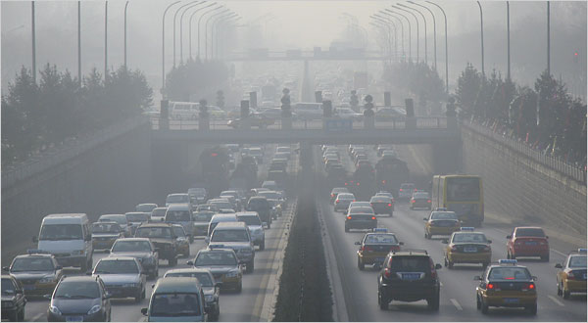
Pollution
The extraction, transport, and burning of fossil fuels is also a highly polluting process.

Slide 6
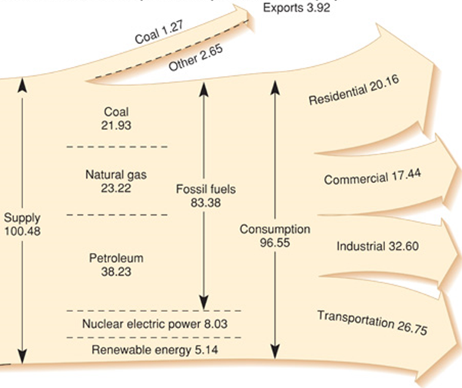
Fossil fuels have a lot of modern applications.
Electricity
Fuel for transportation
Heat
The strategies for replacing them is going to vary for each.

Slide 7
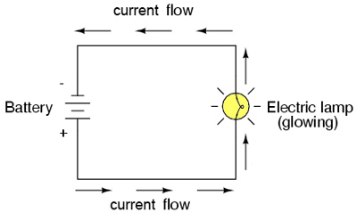
Electricity
Electricity works by passing electrons from a power source through a series of wires, called a circuit.
Within the circuit there are devices that use the energy released by the electrons to do work (as light, heat, etc)

Slide 8
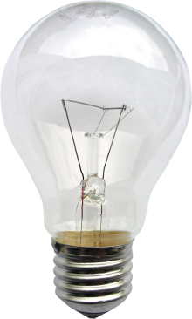
Electric power is measured in watts, the rate at which electrons moving through a circuit are doing work.
A standard incandescent light bulb consumes 60W of power.
A medium-sized car will consume about 100,000W.

Slide 9
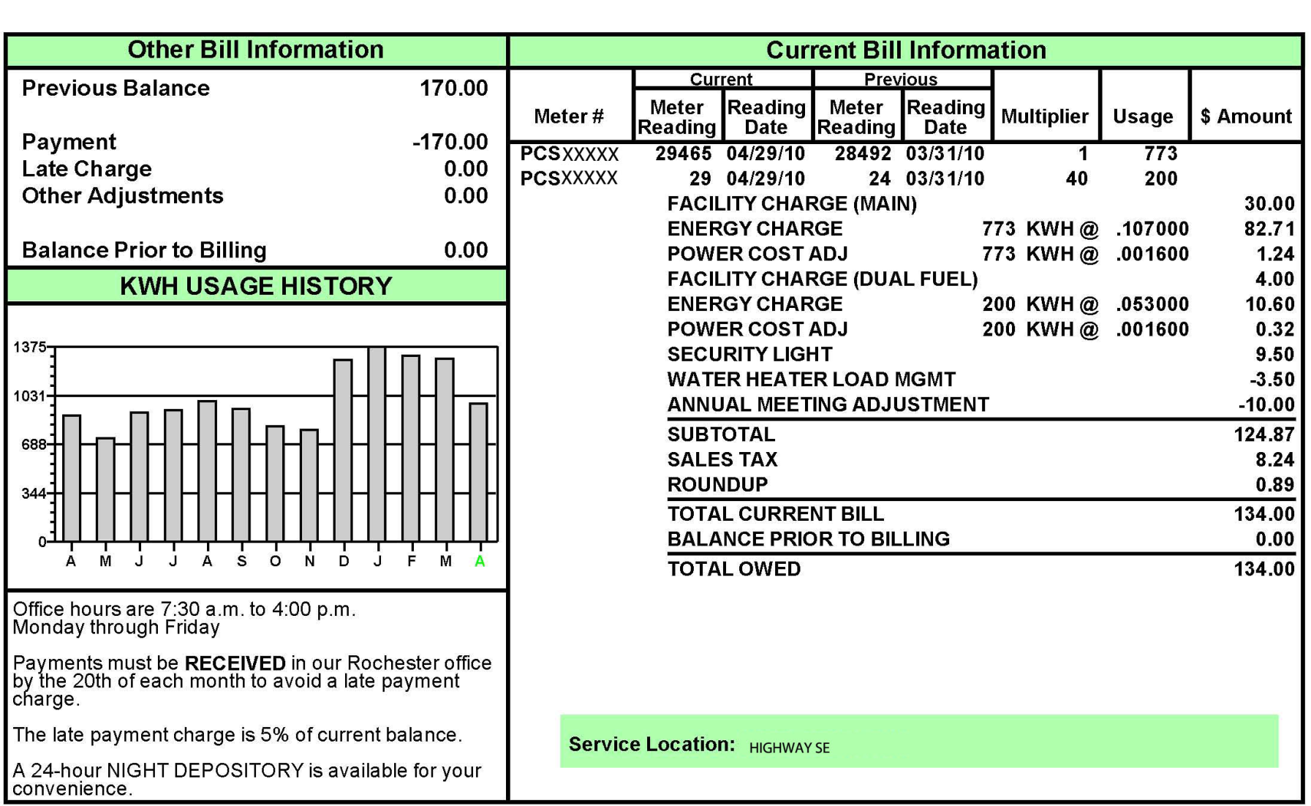
Electricity consumption is measured in kilowatt-hours.
This includes both power and running-time.
The charge per kilowatt-hour in this bill is 10.7 cents.

Slide 10
At the rate shown in this bill, running a 60-watt light bulb for an hour would cost…
60watts x 1 kilowatt/ 1000 watts = 0.06 kilowatts
0.06 kilowatt-hours x $0.107/kwh = $0.00642 or 0.662 cents.

Slide 11
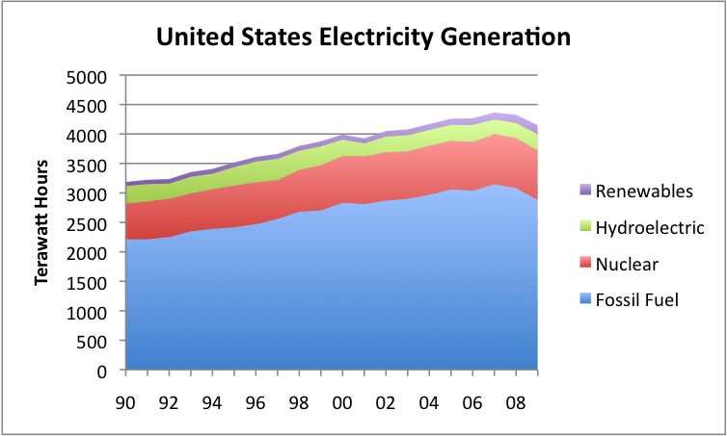
Renewable Electricity
The greatest renewable source of electricity production currently in use is hydroelectricity.

Slide 12
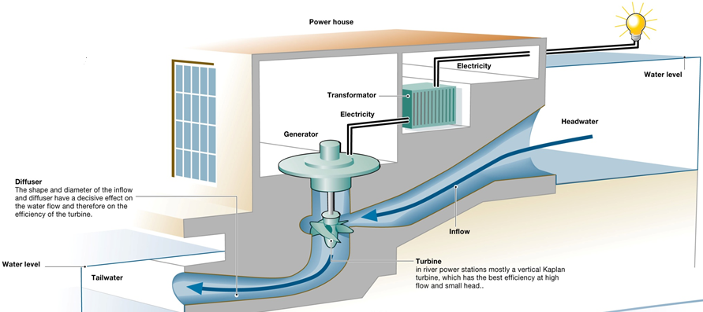
Hydropower
Hydroelectric power plants use running water to spin a turbine and generate electricity.
Hydroelectricity is very economical, with costs per kilowatt-hour similar to coal.
No pollution is produced.

Slide 13
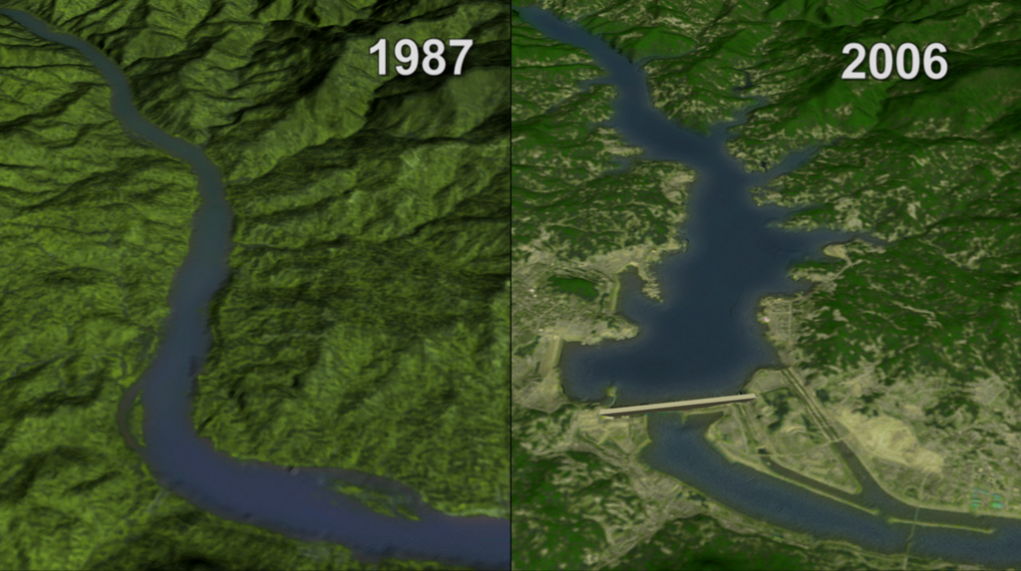
The construction of the dam has major ecological impacts.
Regular flooding downstream stops, preventing deposition of silt and nutrients.
The reservoir can experience sedimentation, where particles of soil in the river settle to the bottom of the reservoir.
The ecosystem immediately behind the dam becomes flooded.
River water, when stopped, warms faster and begins to evaporate.
Fish and other organisms can no longer move upstream.

Slide 14
Any cities or villages in the area of the reservoir will have to be abandoned.
The Three Gorges Dam in China, completed in 2008, displaced 1.13 million people from the Yangtze River region.

Slide 15
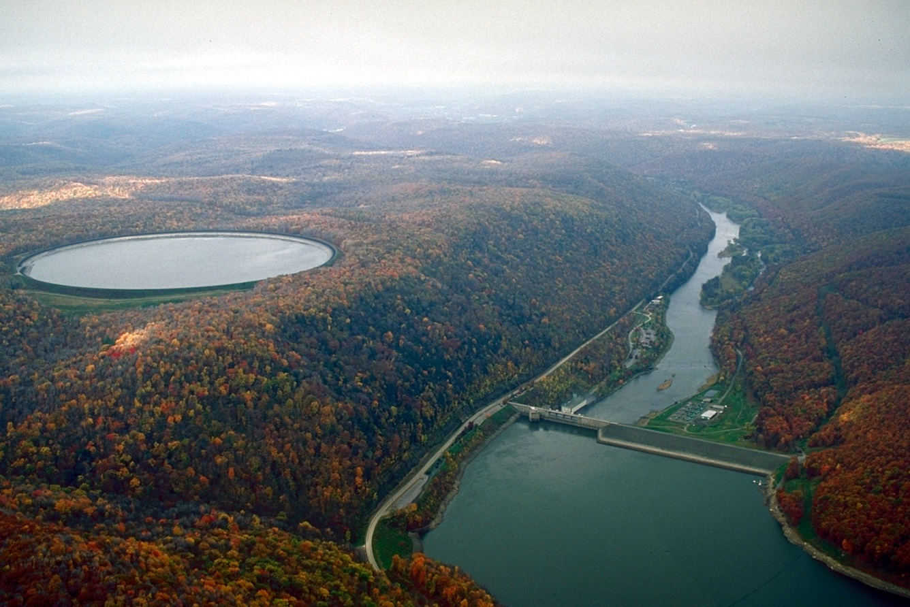
Another issue with dams is that they produce a constant, steady stream of electricity that cannot be easily adjusted to meet demand.
Some dams have pumped storage, where water will be sent and stored during low-demand times, then returned back through the dam’s turbines when demand is higher.
Kinzua Dam and Seneca pumped storage generating station, Mead, PA

Slide 16
Wind Energy
Wind energy is similar to hydroelectricity, except that moving air provides the force to spin the generator.

Slide 17
Wind turbines are able to orient themselves to face the oncoming wind.
As the air passes through, the blades rotate.
These are attached to a shaft, which connects to the turbine.

Slide 18
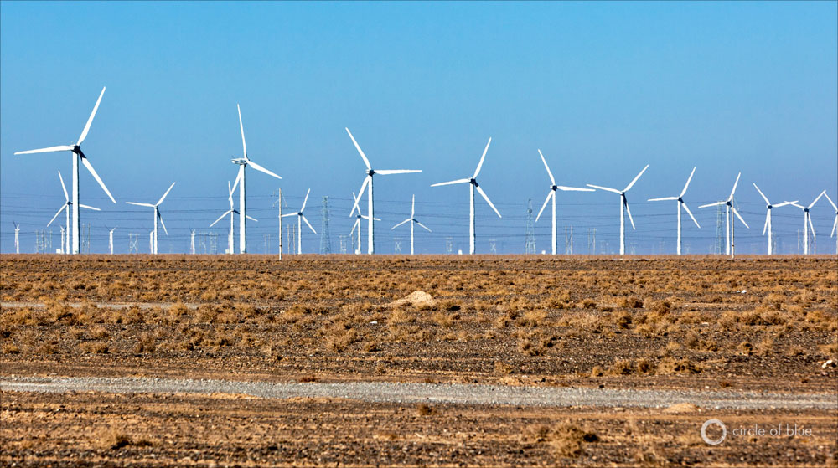
A single wind turbine can generate 1-7 megawatts of energy per year, not enough for a large population.
Wind farms are large numbers of wind turbines clustered together.
The Gansu Wind Farm in China produces 6 billion kilowatt-hours of electricity per year.

Slide 19
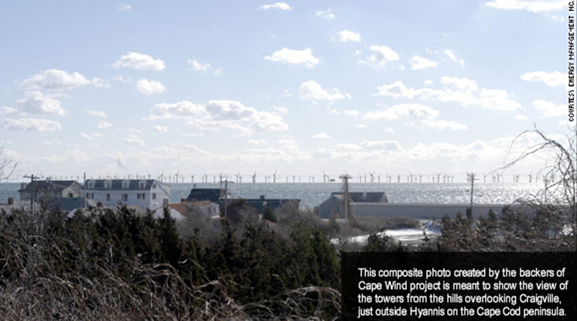
Wind power is comparable in cost to coal.
Possible negative impacts of wind turbines include:
Disruption of bird and bat migration pathways.
Noise.
Disruption of scenery.

Slide 21
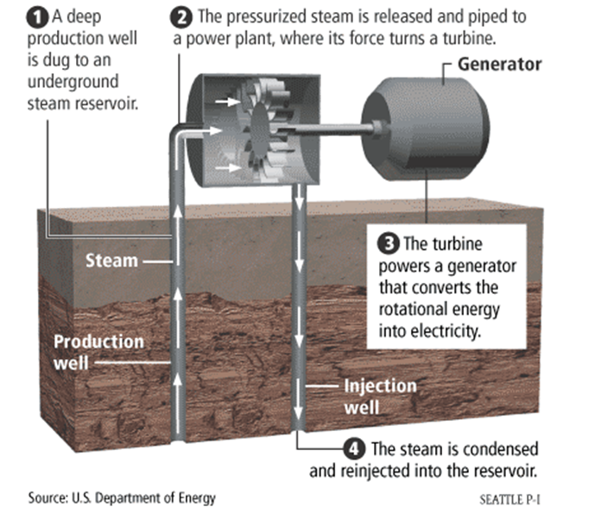
Geothermal Energy
Geothermal power, like nuclear and coal, works by boiling water to steam.
Naturally-occurring heat from the Earth is used in place of fuel.
At a geothermal plant, two wells are drilled.
One injects cold water towards the underground heat.
The second directs steam to the turbine.

Slide 22
Solar Energy
An enormous amount of energy (over 1,000 watts per square meter) hits the Earth every day.
This energy is very diffuse, spread out across the entire surface area of the planet.
Two separate technologies have been developed to convert solar energy into electricity.

Slide 23
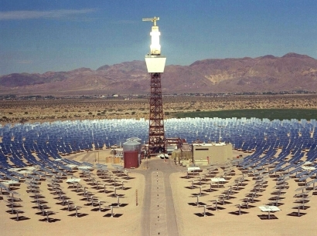
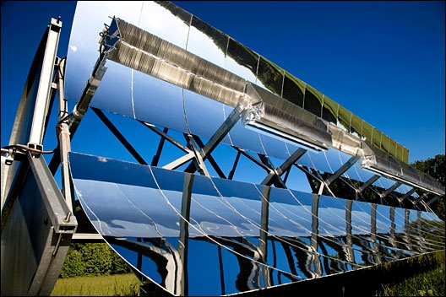
Parabolic solar collection involves using curved reflective surfaces that collect light and focus it onto a concentrated point.
The heat is absorbed and used to boil water into steam, which spins a turbine.

Slide 24
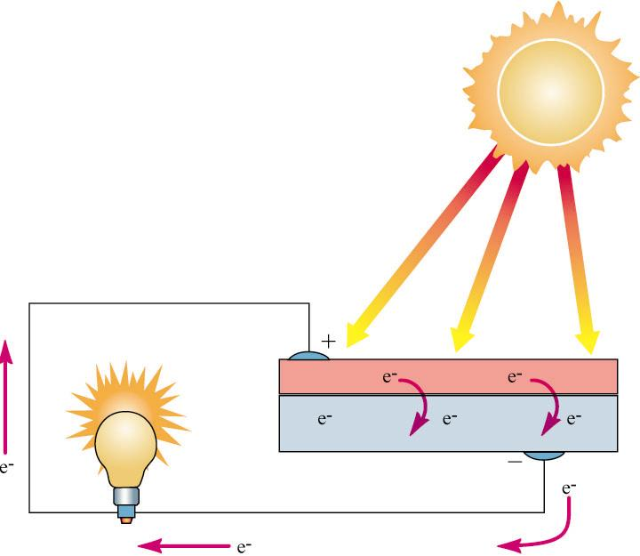
Photovoltaic cells capture solar energy and convert it directly to electrical current.
Solar electricity tends to be 1.5-2 times the cost of electricity from coal or other renewable sources.
Not available on overcast days or at night.

Slide 25
Geography
Electricity generation by solar, wind, hydrokinetic, or geothermal plants is restricted by the natural geography of the United States.

Slide 26
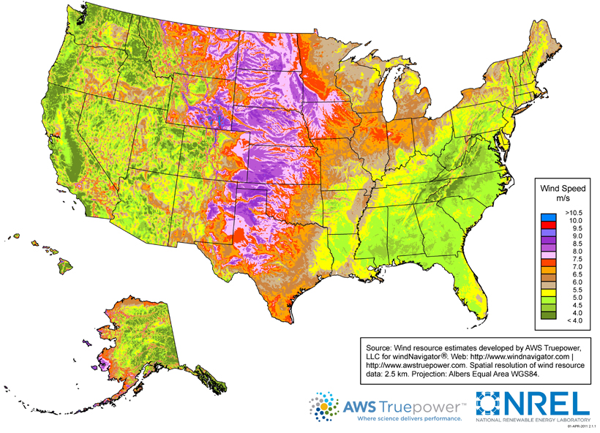
The Great Plains have the highest average wind speeds and the greatest potential for wind power.

Slide 27
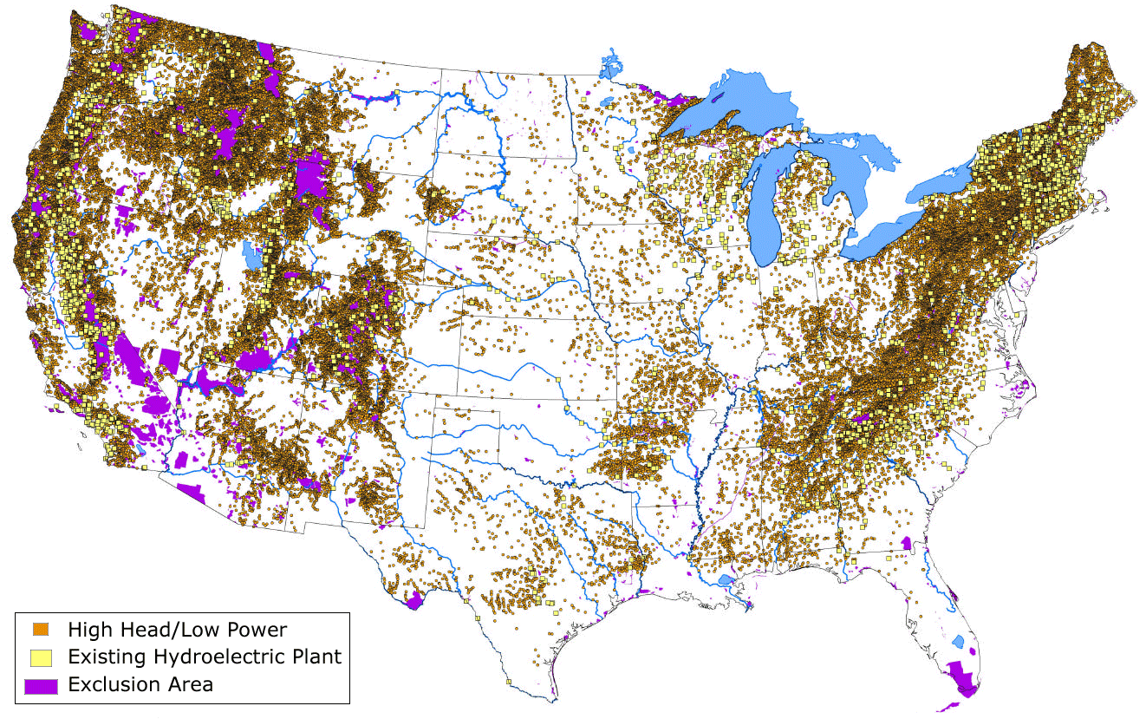
Areas with significant elevation differences and river courses are ideal for hydroelectricity generation.

Slide 28
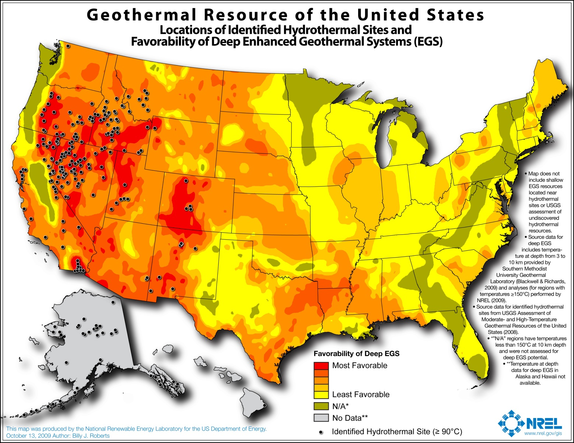
The western states are the most favorable for geothermal energy production.

Slide 29
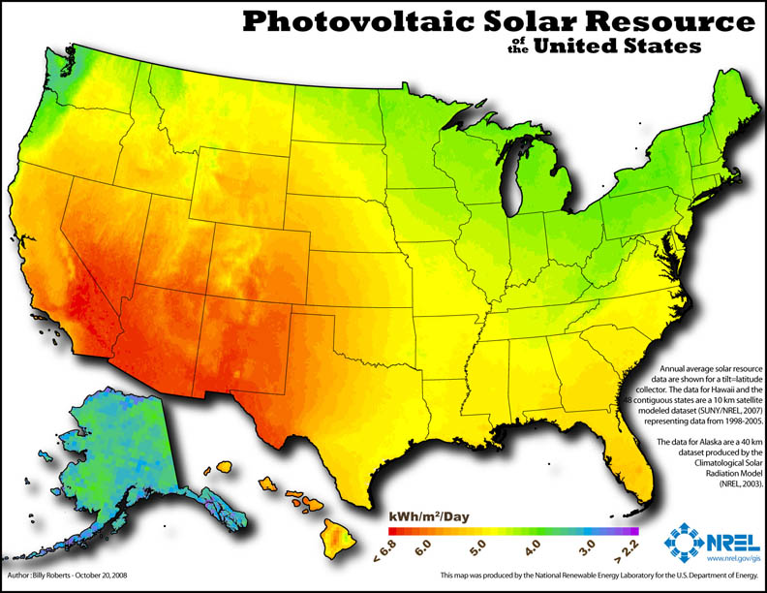
The deserts of the southwest are ideal for solar electricity generation.

Slide 30
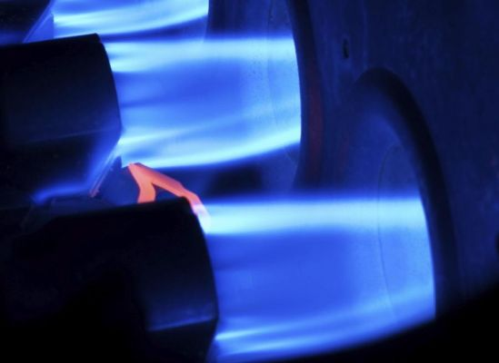
Heat
Besides electricity, significant amounts of fossil fuels are burned for heat, especially natural gas.

Slide 31
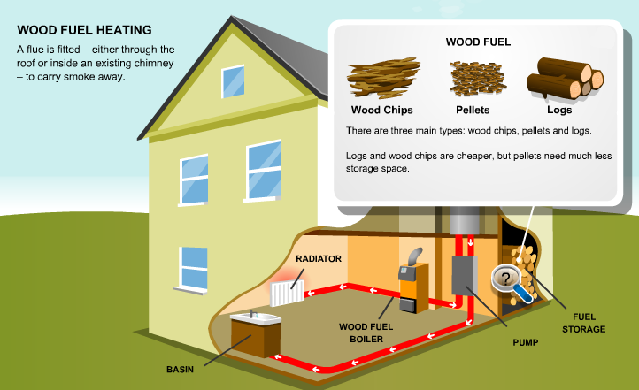
Biomass
Traditionally, humans have relied on burning biomass, such as wood, charcoal, and dung as a source of heat.
These fuels will replenish, but produce similar levels of pollution to fossil fuels.
Excess demand can also lead to deforestation.

Slide 32
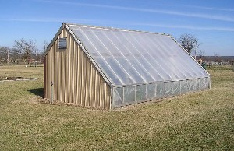
Solar Heating
Energy from the sun can also be gathered to use as a source of heat.
Passive solar heat structures have no moving parts, but use south-facing windows to gather and absorb as much solar heat as possible.

Slide 33
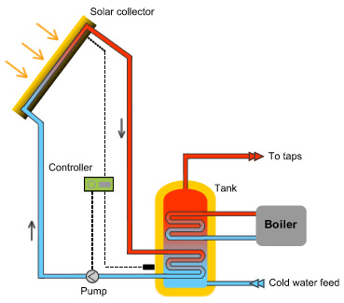
Active solar heat structures pump water or another liquid through a collector.
Can be used for household radiant heating, or as a source of hot water for showers and cooking.
Image source: www.almeriaspas.com

Slide 34
Transportation
The third major energy need is fuel for transportation.
Most of the cars, planes, and ships of the world run on petroleum products – gasoline, diesel, etc.

Slide 35
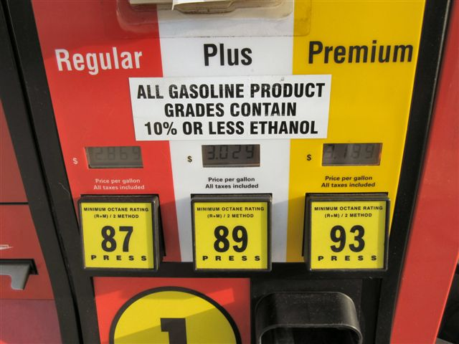
Alternative Fuels
Vehicles can be run on other fuels besides petroleum-based ones.
Biofuels, like ethanol, are generated from using bacteria or yeast to ferment plant matter.
Currently, the biggest source of this plant matter is corn. This can influence food prices.

Slide 36
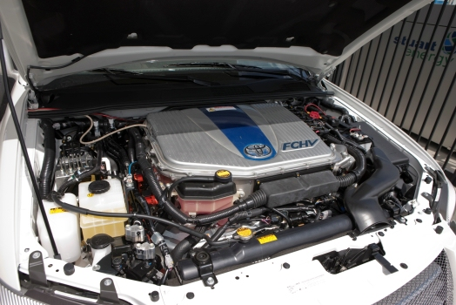
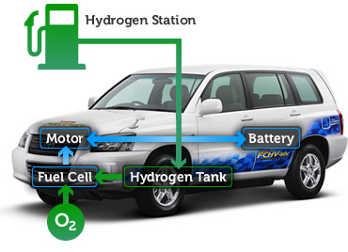
Hydrogen fuel cells use a chemical reaction between hydrogen and oxygen gas to generate an electric current.
H2 + O2 → H2O
Refueling is difficult, as pure hydrogen is a gas and difficult to store and transport safely.
No waste products are produced, except for water vapor.

Slide 37
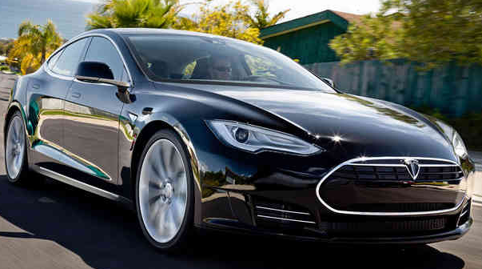
Cars could be indirectly run on renewable energy if they had powerful enough batteries to store a charge needed to run the car for long periods of time.
Lead-acid batteries, currently in use, are too large and do not hold enough energy.
Nickel-Metal Hydride batteries, used in early generation hybrid cars, have a higher storage capacity, but will quickly lose a stored charge when not in use.
Lithium-ion batteries are the smallest and have the best storage capacity, but are also expensive to produce.
The Tesla Model S runs on lithium-ion batteries, with a range of 265 miles.

Slide 38
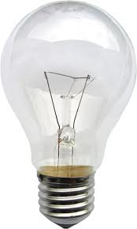
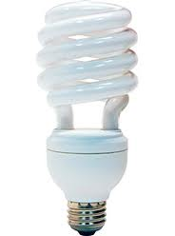
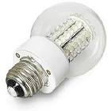
Energy Conversion Efficiencies
In addition to finding alternative, renewable energy sources, it is also important to reduce energy consumption.
Energy Efficiency is a measure of the percentage of energy consumed that actually performs the desired work.
Incandescent light bulbs: 5-10% efficient
Compact fluorescent: 20-33% efficient
LED: 40-60% efficient

Slide 39
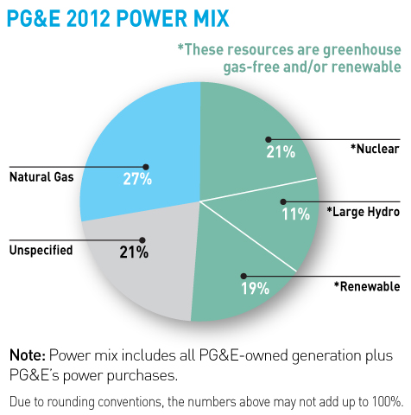
Promoting Renewable Energy
Distributional surcharges are small charges levied on all utility customers to help finance research and development of renewable energy.
A renewable portfolio is a state mandated minimum percentage of energy that utilities must get from renewable sources.
Green pricing is the practice of some electricity suppliers offering plans (at a premium) that only use renewable sources for electricity.
California has enacted a 33 percent renewable portfolio standard set for 2020.

Slide 40
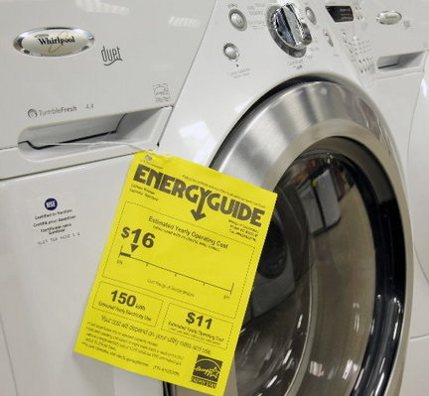
Promoting Renewable Energy
The energy star program is a federal initiative to promote and provide incentives for purchasing more efficient devices and appliances.

Slide 41
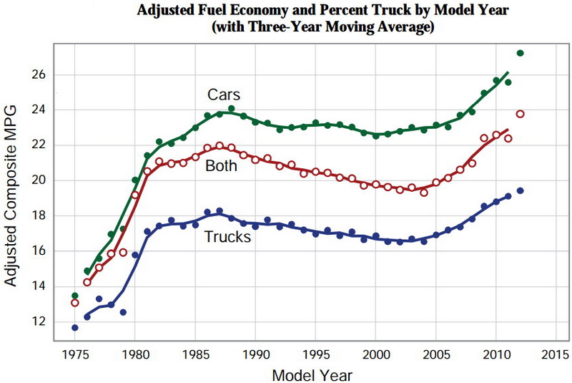
Energy conservation tends to be highly tied to consumer prices.
In response to 1970’s oil prices, average U.S. automobile gas-mileage increased from 13 mpg in 1975 to 28.8 mpg in 1988.

Slide 42
Falling fuel prices in the 1980s-early 2000s discouraged further improvements in fuel economy.
The recent popularity of smaller cars, hybrid cars, and electric cars has improved average MPG again.

