Slide 1
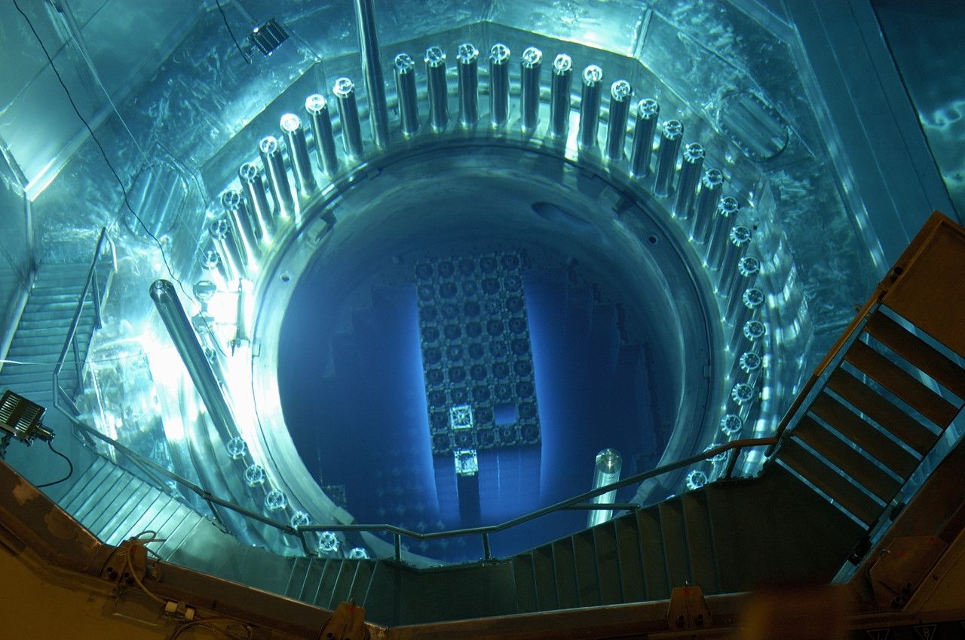
Nuclear Energy
“Nuclear power is a hell of a way to boil water.” - Albert Einstein

Slide 2
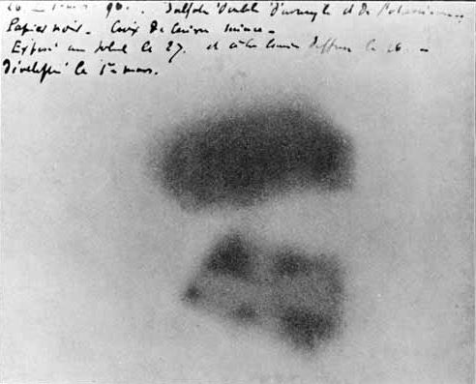
Discovery of Radioactivity
In the late 1800s, a scientist named Antoine Becquerel performed an experiment where a uranium salt was placed in a dark area with a photogenic plate and a copper Maltese cross.
The uranium left an imprint on the plate, with a “shadow” in the area where the cross was.
Becquerel had discovered that certain substances could release their own energy.

Slide 3
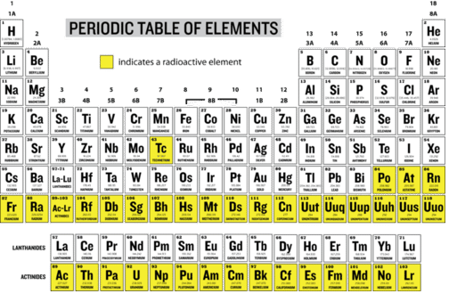
Radioactive elements tend to be ones with larger atoms, near the end of the periodic table.

Slide 4
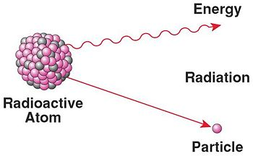
Gold Foil Experiment
Radioactive atoms have unstable nuclei that will decay and release smaller particles and ionizing radiation.
Ionizing radiation includes any wavelength or frequency of energy that is able to remove electrons from other atoms.
Gamma rays, X-rays, and some forms of ultraviolet light are ionizing.

Slide 5
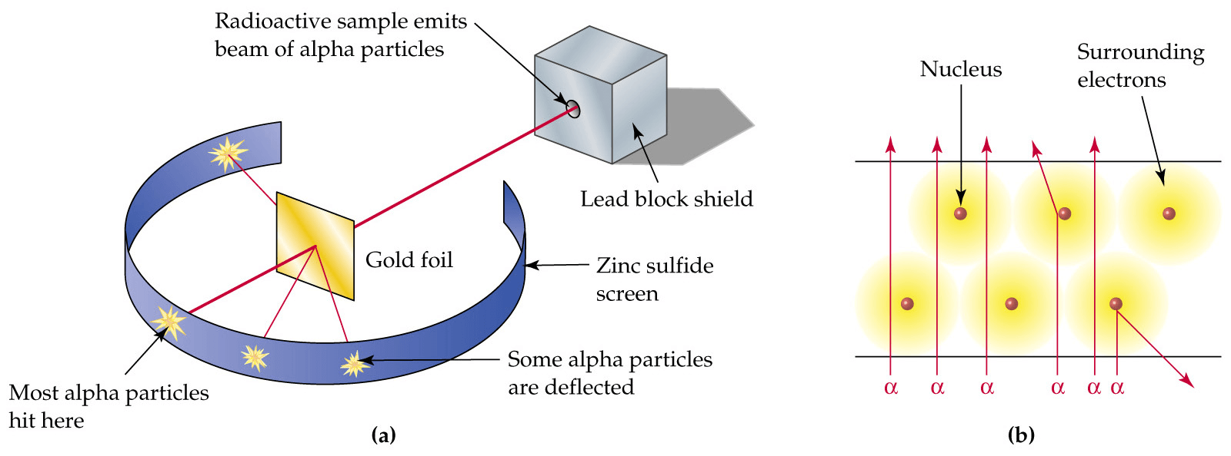
Gold Foil Experiment
In the early 1900s, Hans Geiger and Ernest Marsden performed an experiment where a beam of particles generated by the decay of an even more radioactive element called radium was directed at a thin sheet of gold foil.
Most of the particles released by the radium passed through the gold foil, but a few (about 1/6000) deflected back.

Slide 6
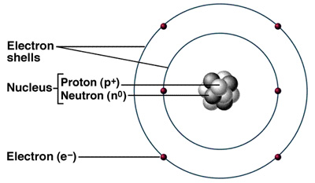
This experiment yielded two very important conclusions about atoms:
Atoms are mostly empty space.
Atoms have a dense inner nucleus.
The nucleus of the atom is now known to contain two types of subatomic particles of equal mass:
Protons, which carry a positive charge and determine the atom’s identity.
Neutrons, which have no charge and help to stabilize the nucleus.
Electrons are negatively-charged particles with very little mass that orbit the nucleus.

Slide 7
Isotopes
Isotopes are atoms of the same element with different numbers of neutrons, and different atomic masses.
Isotopes are notated with their chemical symbol and mass.

Slide 8
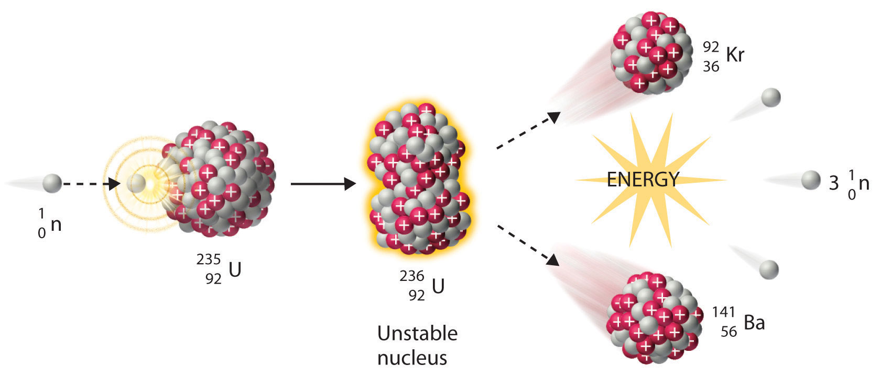
Nuclear Fission
Nuclear fission is when atoms with very large nuclei can be split into smaller atoms when they are hit with protons or neutrons.
This releases large amounts of energy, as well as individual neutrons.

Slide 9
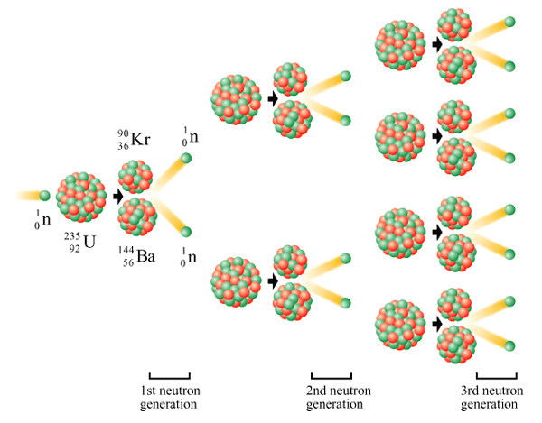
When enough of these large atoms are clustered together and fission is initiated in one of them, a fission chain reaction will occur as released neutrons will trigger fission in neighboring atoms, eventually traveling through the entire sample.
This reaction is the primary source of energy behind nuclear bombs and nuclear reactors.

Slide 10
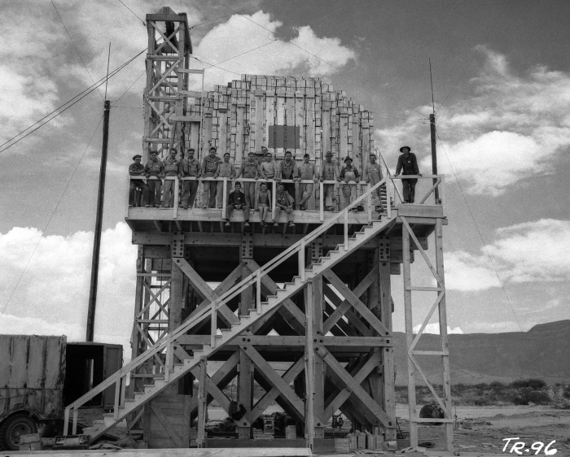
The 100 Ton Test
On May 7, 1945, 108 tons of TNT stacked and threaded with radioactive material was detonated in the White Sands desert in New Mexico.
This 0.1 kiloton explosion was meant to calibrate the instruments that would measure the actual nuclear bombs to be tested later.

Slide 11
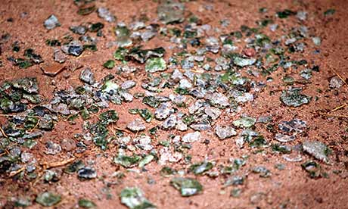
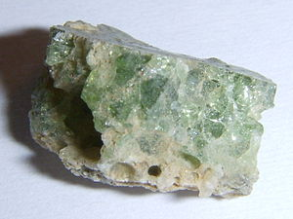
Trinity
The first nuclear test detonation, code-named “Trinity”, was conducted in the New Mexico desert in 1945.
Following the explosion, a radioactive green glass now called “Trinitite” was found on the desert floor.

Slide 12
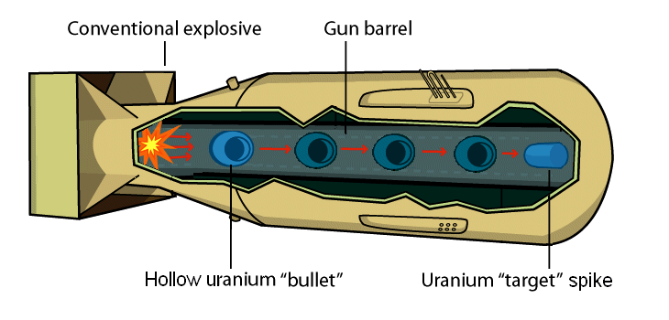
Fission bombs like trinity had three components:
A critical mass, meaning a cluster of fuel (uranium or plutonium) with enough concentration of neutrons to sustain a fission reaction.
A neutron generator that will generate the initial neutrons needed to start the reaction.
A bullet that is released at a certain altitude (before impact with the ground) to trigger the neutron generator .

Slide 13
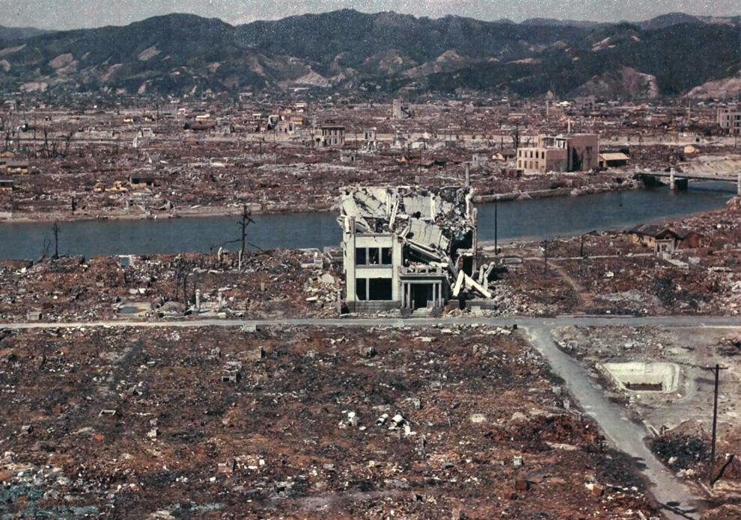
Two atomic bombs were dropped during World War II – over the cities of Hiroshima and Nagasaki, Japan.
Each had yields of 15-21 kilotons of TNT.
Hiroshima, March 1946.

Slide 14
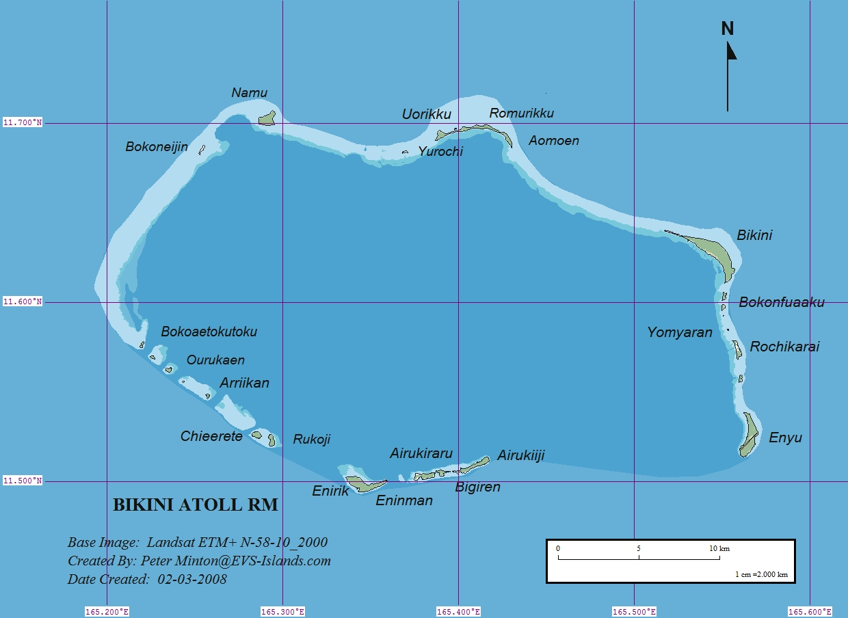
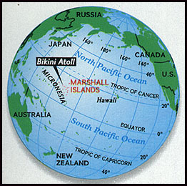
Pacific Nuclear Testing
Following World War 2, additional nuclear weapons testing was moved to part of the Marshall Islands, called the Bikini Atoll (11°N, 165°E).
This testing was codenamed “Operation Crossroads.”

Slide 15
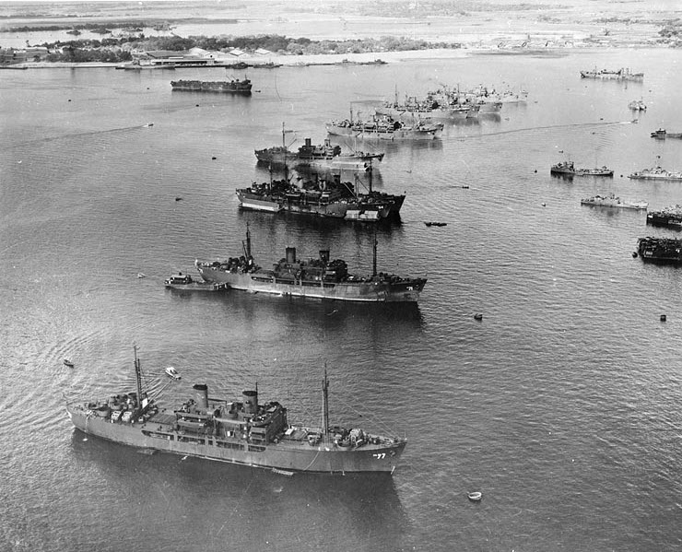
Two nuclear devices were detonated at sea as part of Operation Crossroads.
The purpose was to study the effects of a nuclear blast on an armada of naval ships.
Different species of lab animals were placed on several ships, to test for radiation sickness and burns following the blast.
The first blast, called Shot Able, was dropped from a plane. The second, Shot Baker, was detonated underwater, beneath the ships.
A third blast was planned, but cancelled due to the damage caused by Shot Baker.

Slide 16
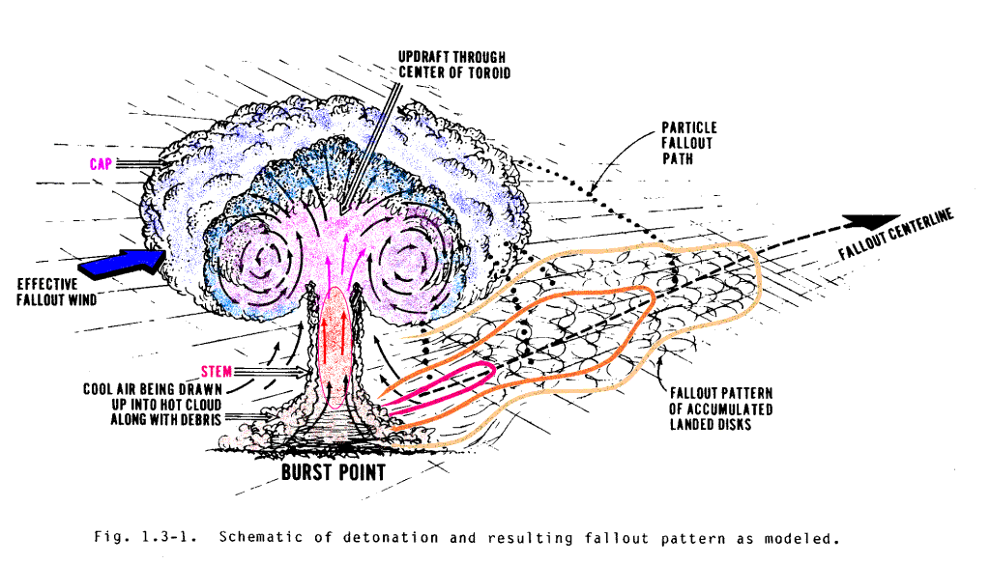
Glenn Seaborg, chairman of the Atomic Energy Commission, called Baker “the world’s first nuclear disaster” due to the heavy contamination of fallout.
Radioactive fallout is radioactive material that is propelled into the atmosphere following a nuclear blast.
Its name comes from the fact that it “falls out” of the sky after the explosion.
Fallout was spread across a large part of the ocean, including the naval ships.

Slide 17
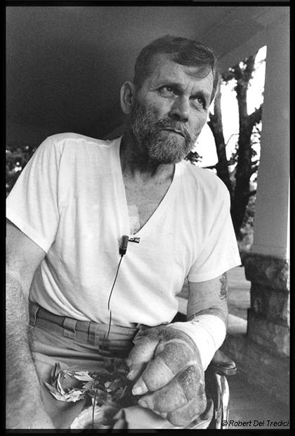
Radiation sickness is a combination of symptoms that occur following exposure to radioactive fallout and ionizing radiation.
Symptoms range from skin blistering, vomiting, and diarrhea to cancer or death.
Severity depends on two factors:
The dose, or the amount of exposure to the radiation.
The route of exposure – inhalation, ingestion, or dermal (through the skin).
Whether the dose is acute (single high-level exposure) or chronic (multiple low-level exposures).
John Smitherman, an Operation Crossroads sailor.

Slide 18
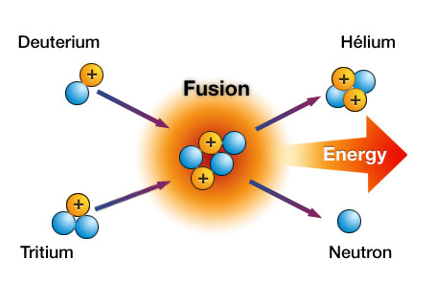
Nuclear Fusion
These early bombs were not very efficient, with less than 2% of the uranium actually undergoing the fission reaction.
Hydrogen bombs include a chamber of hydrogen gas wrapped with the plutonium-239 fuel.
The heat of the plutonium fission causes the hydrogen atoms to undergo fusion.
Nuclear fusion is a reaction where two small atoms (usually hydrogen) join together to form a larger one.
This also releases heat and particles (neutrons and protons).

Slide 19
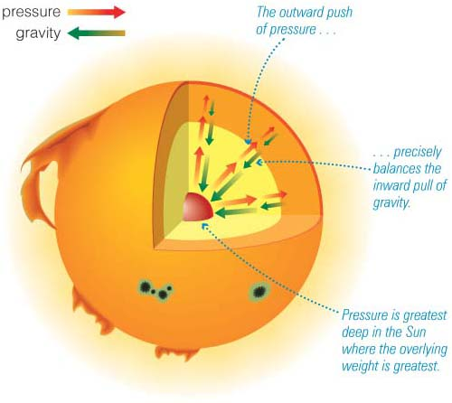
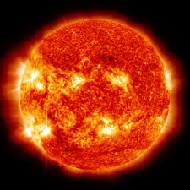
Nuclear fusion is the reaction that powers stars, and requires a tremendous amount of heat to occur.

Slide 20
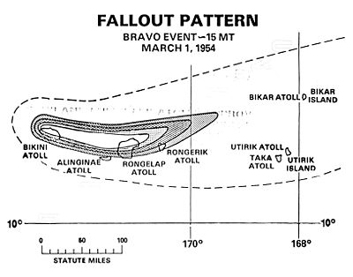
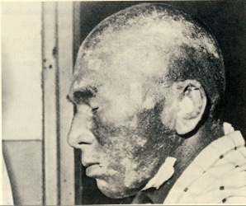
Castle Bravo
The United States tested its first hydrogen bomb in 1954, code-named Castle Bravo.
Castle Bravo was a much more powerful blast than expected, and produced a tremendous amount of fallout in the form of coral dust.
Residents of nearby atolls and Japanese fishermen on a tuna fishing boat called the Lucky Dragon 5 was also caught in the blast radius.
In 1963, the United States, Soviet Union, and United Kingdom signed the Partial Test Ban Treaty, agreeing to ban all future nuclear tests, except for those conducted underground.

Slide 21
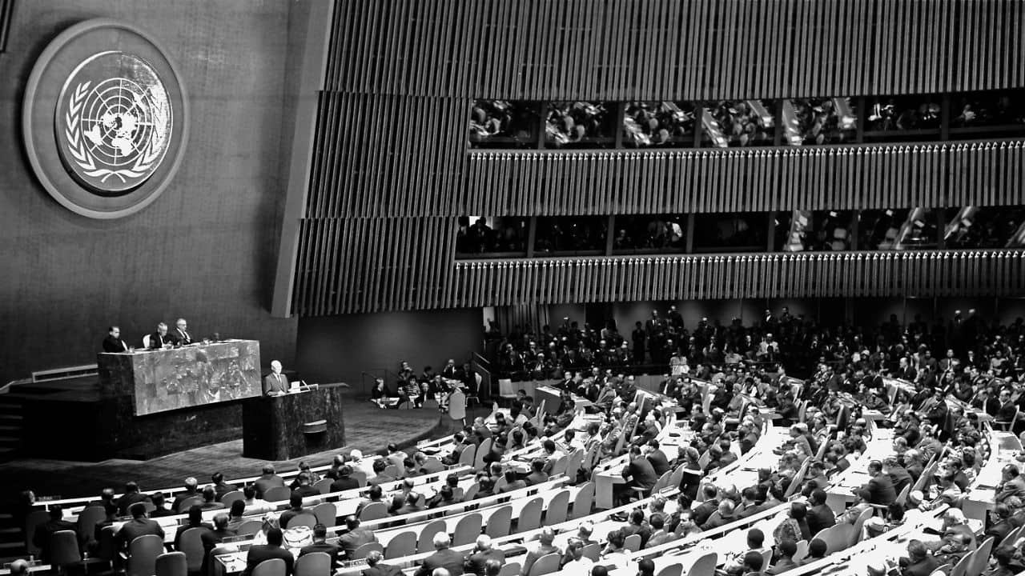
Atoms for Peace
As the Bikini nuclear testing continued, President Dwight Eisenhower gave a famous speech to the United Nations:
“…the United States pledges before you…its determination to help solve the fearful atomic dilemma--to devote its entire heart and mind to find the way by which the miraculous inventiveness of man shall not be dedicated to his death, but consecrated to his life."

Slide 22
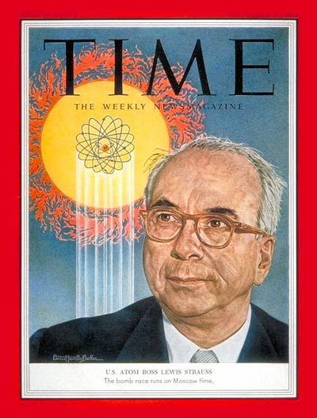
Nuclear technology and research was provided to schools, hospitals, and research institutions to help develop nuclear reactors and medical treatments.
Lewis Strauss, chairman of the Atomic Energy Commission, predicted that, with nuclear power…
“Our children will enjoy in their homes electrical energy too cheap to meter.”

Slide 23
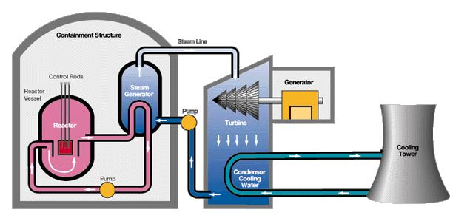
Nuclear Reactors
Nuclear reactors work by taking the heat energy released by nuclear fission and converting it between many different forms.
The steam generator absorbs the heat from fission and uses it to boil water into steam.
The turbine converts the thermal energy of steam into mechanical energy of a spinning rotor.
The generator converts the mechanical energy into electrical energy, which can then be conducted through a wire.
The cooling tower releases excess heat in the form of steam.

Slide 24
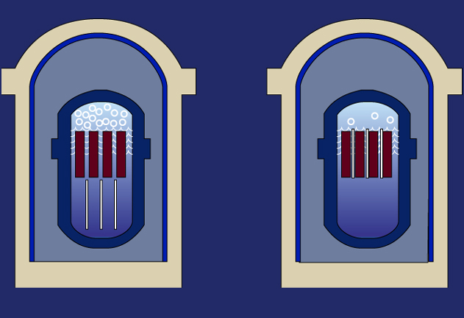
Inside the reactor, fuel rods contain is uranium-235, plutonium-239, and plutonium-241.
Control rods, made of a neutron-absorbing material, are placed amongst the fuel rods and can be inserted or withdrawn to adjust the rate of the reaction.
The moderator is a liquid (usually water) that pumps heat away from the fuel rods and towards the steam generator.
Withdraw control rods,
reaction increases
Insert control rods,
reaction decreases

Slide 25
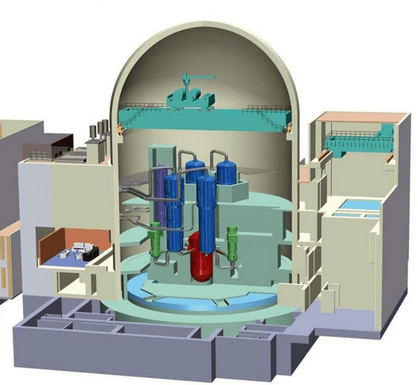
Both reactor vessel and steam generator are housed in a special containment building made of layers of concrete and steel.
Prevents the escape of all forms of radioactive decay.

Slide 26
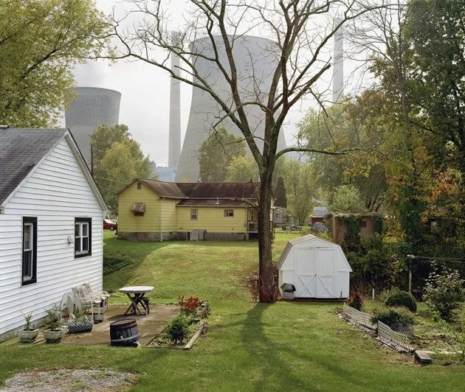
Nuclear power plants, when operating properly, do not release any air or water pollution, fallout, or radiation.
Cooling Tower in Byron, Illinois

Slide 27
Nuclear Boom and Bust
Through the 1970s, many new nuclear reactors were ordered and constructed.
Since that initial boom, only three have come online, including none in the past decade.

Slide 28
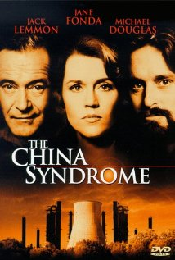
In 1979, a movie called “The China Syndrome” was released.
Fictional story about a California nuclear plant that experienced a near-meltdown of its nuclear core.
The title of the movie is an exaggeration of what happens during a meltdown – the nuclear core becomes so hot that it melts, even melting through the floor of the reactor vessel.
A full meltdown is the worst-case scenario for nuclear power plants, as it ruins the reactor and potentially releases fallout into the surrounding air and water.

Slide 29
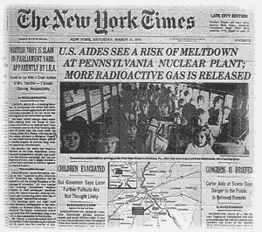
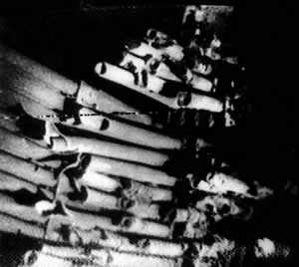
Ten days following the movie’s release, the Three Mile Island partial meltdown occurred.
A relief water valve stuck open, allowing water to escape from the core and uncovering the fuel rods.
The fuel and control rods, without a moderator present, partially melted.
No significant radioactive fallout was released.

Slide 30
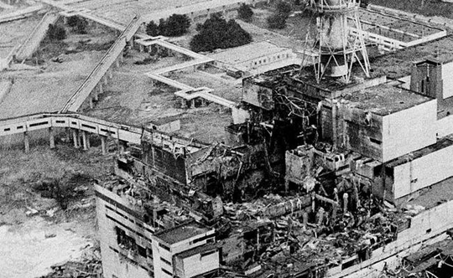
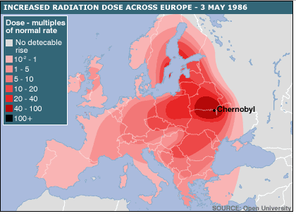
In 1986, a full meltdown occurred at the Chernobyl nuclear plant located in Ukraine (formerly Soviet Union).
An explosion ripped apart the containment building, spreading radioactive fallout throughout the area and into the atmosphere.

Slide 31
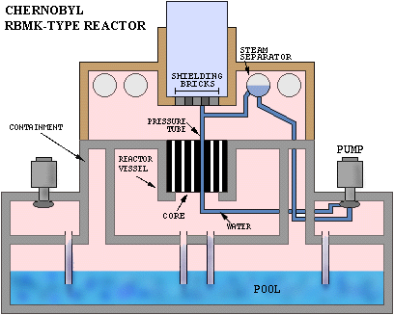
There were multiple design flaws at the Chernobyl plant:
The containment building was inadequate.
Graphite was used as a moderator instead of water. When the meltdown occurred, it burned, releasing more fallout.
A water storage pool was located under the reactor. If the core had melted down into this pool, an even greater explosion would have occurred.

Slide 32
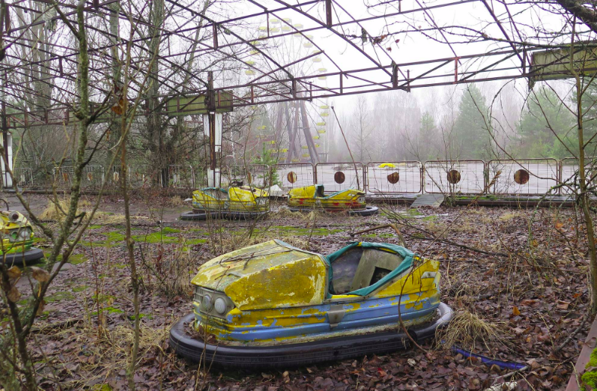
A 30km radius around the plant, called the exclusion zone, has been designated as uninhabitable to people.
The area has been largely reclaimed by nature, and has become a de facto wildlife refuge.

Slide 33
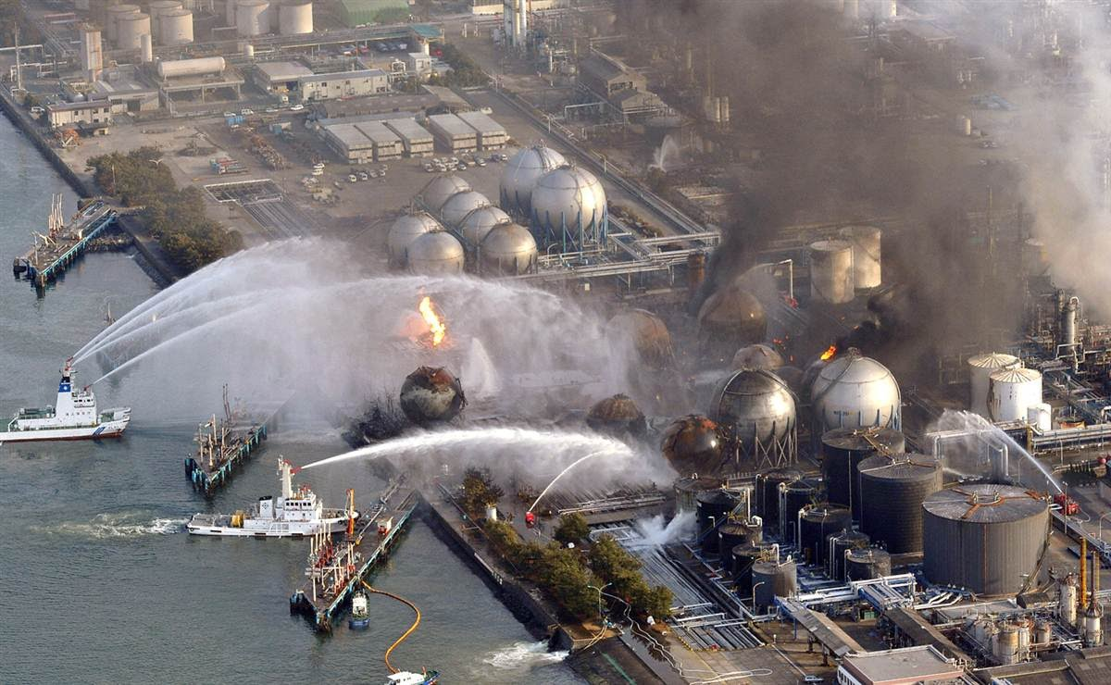
Fukushima
The most recent meltdown occurred following a massive earthquake and tidal wave off the coast of Japan.
The generators powering the water pumps of some of the Fukushima Daiichi reactors were flooded.
Without cooling water, the core overheated and experienced a meltdown.

Slide 34
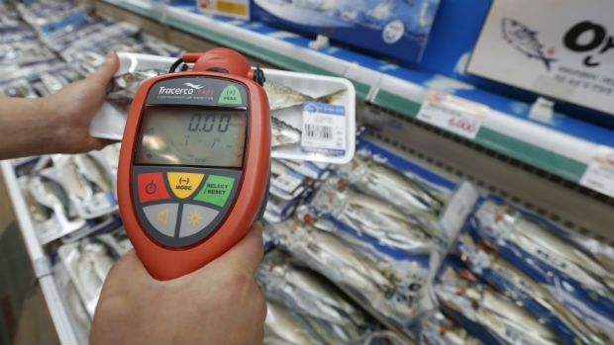
Contaminated water from the plant leaked into the Pacific.
Top predators, like bluefin tuna, caught in the Pacific have positively tested for small amounts of radioactive fallout.

Slide 35
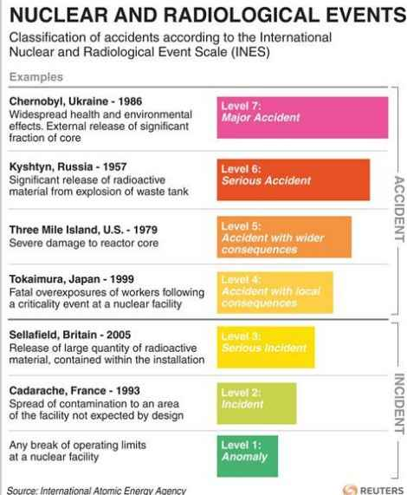
Nuclear and Radiological Event Scale
Nuclear events are rated on a scale of 1-7.
Events that lead to contamination that is contained within the facility are called incidents.
Events that lead to external contamination are called accidents.

Slide 36
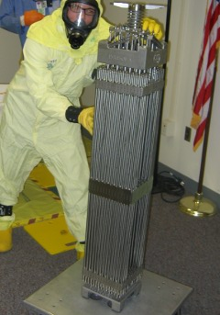
Radioactive Waste Management
Nuclear reactors produce nuclear waste, which is radioactive and hazardous to living organisms.
Low-level nuclear waste includes tools and work clothing from power plant employees.
Makes up the majority (90%) of nuclear waste, but is only slightly radioactive.
High-level nuclear waste is all of the used fuel rods that no longer perform enough fission to generate electricity.
Makes up only 3% of nuclear waste, but is highly radioactive and dangerous.

Slide 37
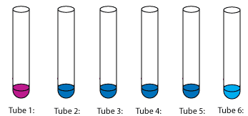
All radioactive material, including waste, has a half-life, or given amount of time needed for half of the sample to decay into smaller, less harmful elements.
If enough time passes, nuclear waste will degrade into a non-toxic form!
Cesium-137, for example, has a half-life of about 30 years, so if you started with a sample of cesium-137…
In 30 years, 50% of the original isotope would remain.
In 60 years, 25% of the original isotope would remain.
In 90 years, 12.5% of the original isotope would remain.

Slide 38
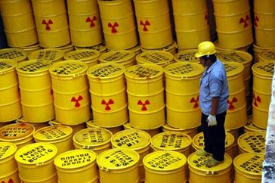
Short-lived isotopes may only have a half-life of 4-29 years.
Longer-lived isotopes may have a half-life of thousands of years.
Plutonium-239 is one of the most dangerous, and has a half-life of 24,110 years.
Nuclear waste requires a long-term storage solution, which countries have yet to agree upon.

Slide 39
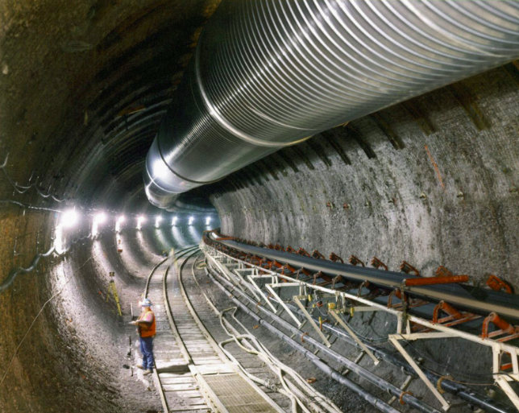
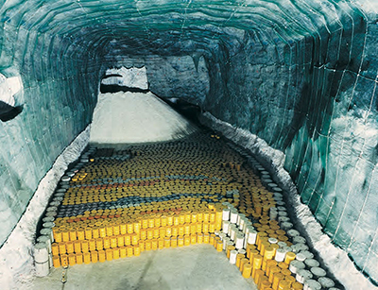
The United States built a waste repository into the Yucca Mountain in Nevada, but local opposition has halted its use.
Waste is currently held in tall casks of concrete and steel until a plan is agreed upon.
Many European countries use deep geologic disposal in underground salt formations at depths of 250-5000 meters.

Slide 40
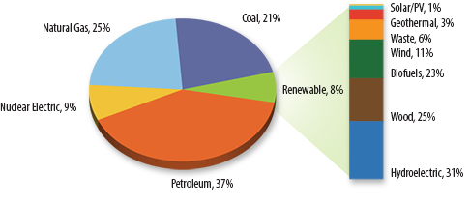
Overall, nuclear energy makes up only a fraction (about 9%) of our total energy generation.
Its use may increase in the future, as fossil fuels become more scarce or are considered too environmentally damaging.

