Slide 1
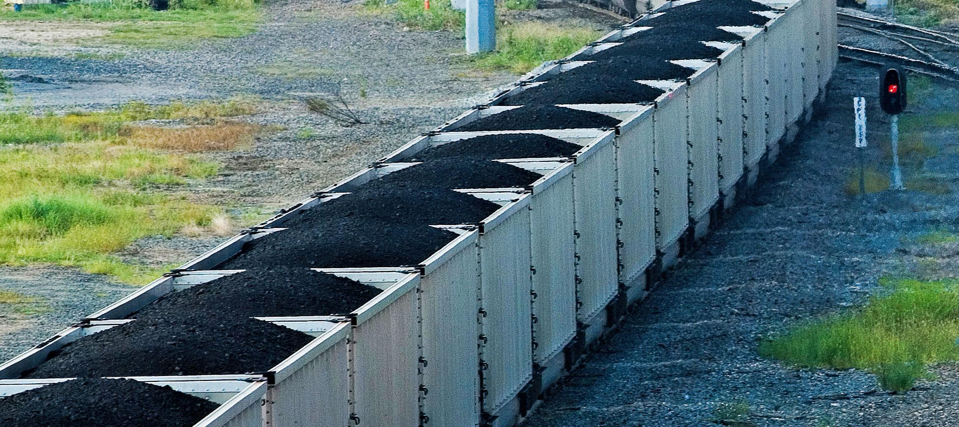
Nonrenewable Energy - Fossil Fuels
“Our civilization runs by burning the remains of humble creatures who inhabited the Earth hundreds of millions of years before the first humans…”
- Carl Sagan

Slide 2
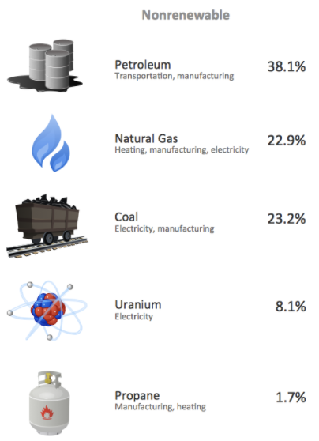
Nonrenewable Energy
Nonrenewable energy resources cannot be readily replaced by natural means.
Fossil fuels are forms of nonrenewable energy that arise from the remains of living organisms over millions of years.
Coal, oil, and natural gas.

Slide 3
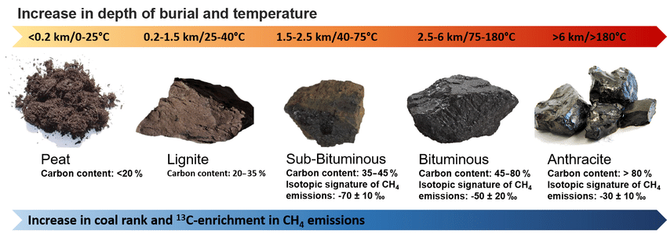
Coal
Coal is a hard, blackish substance that is formed from plant matter that has been highly compressed and pressurized.
When coal is more compressed, its carbon content increases, resulting in a greater energy content.

Slide 4
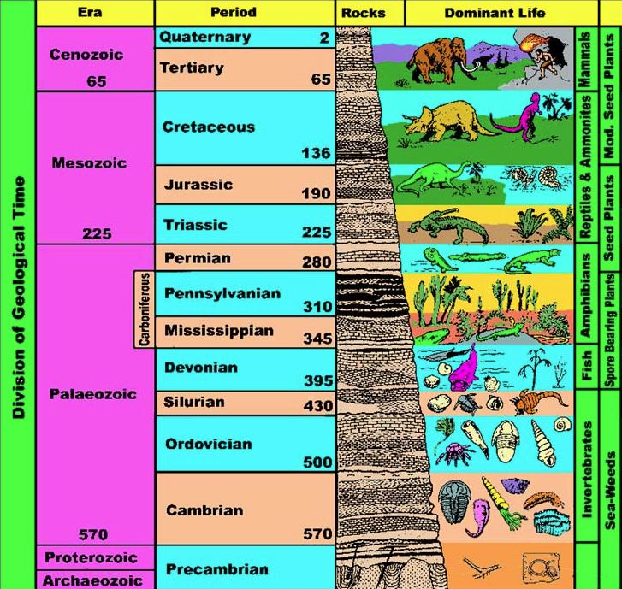
Most coal formed during the carboniferous period, a geologic period lasting from about 360-300 million years ago.

Slide 5
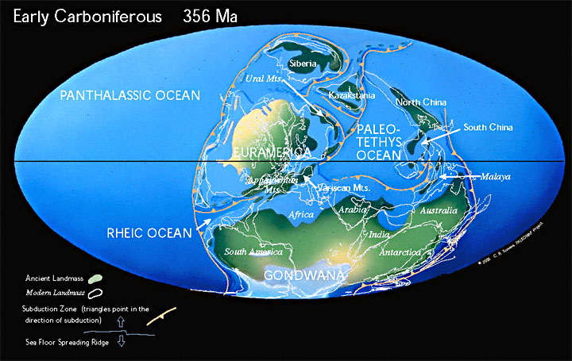
During the carboniferous period, much of the Earth experienced a tropical climate.
The average temperature was about 68°F, compared to an average of 55.5°F in the 20th century.

Slide 6
Fern-like trees evolved the ability to use a tough fiber called lignin to grow tall and stay upright, allowing them to outcompete neighboring trees for sunlight.
The trees had a shallow root system, causing them to fall over easily.
Bacteria and fungi had not yet evolved the ability to digest lignin, so dead trees did not decompose.
Drawing by Robert Krulwich

Slide 7
Over the next several million years, trees grew, aged, died, fell, and were replaced with new trees.
Photosynthesis removed carbon dioxide from the air, replacing it with oxygen.
The oxygen supported the evolution of very large terrestrial arthropods.

Slide 8
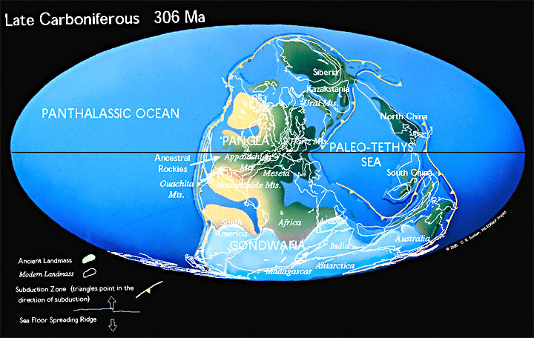
The decrease in atmospheric carbon dioxide weakened the greenhouse effect, causing the global climate to become colder and a glacial expansion.

Slide 9
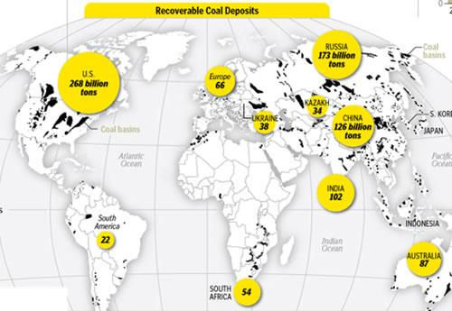
Today, the countries with the greatest coal deposits line up with the locations of largest carboniferous swamps – North America, Eastern Europe, and Asia.

Slide 10
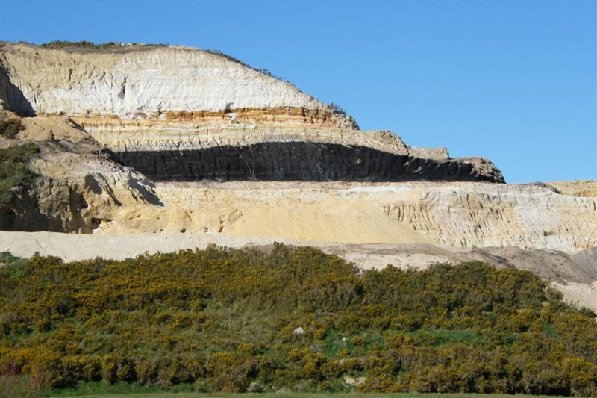
Coal Extraction
Coal mining companies look for coal seams – layers of coal within rock that are thick enough to be profitably mined.
Surface mining techniques are used if the coal is not too deep underground.

Slide 11
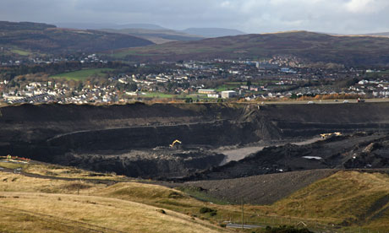
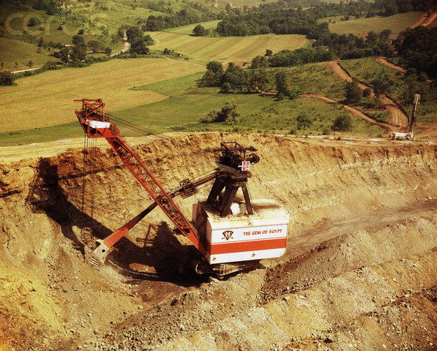
Open-pit mining is where large holes are dug into the earth and the minerals removed.
Strip mining actually carves away horizontal beds of coal deposit close to the surface.

Slide 12
Mountaintop removal uses explosives to blow up entire mountaintops to allow surface mining of coal seams underneath.
This is heavily used throughout the Appalachian mountains, as seen in this slideshow of the Hobet Mine in West Virginia.

Slide 13
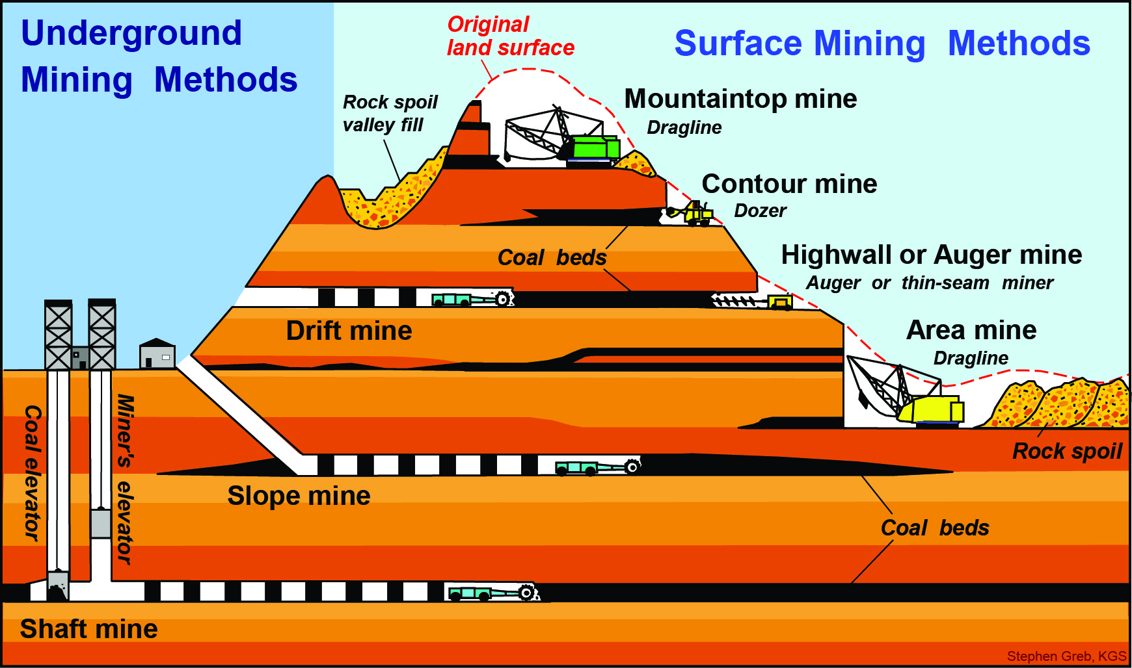
Subsurface, or underground mining, removes coal through deep tunnels and shafts.

Slide 14
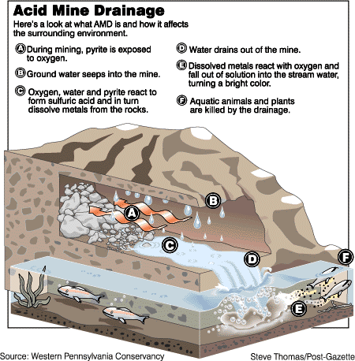
Environmental effects of coal mining
Water can seep through coal mines, dissolving minerals and creating acid mine drainage.
Acidic, metallic, and toxic to many animals and plants.

Slide 15
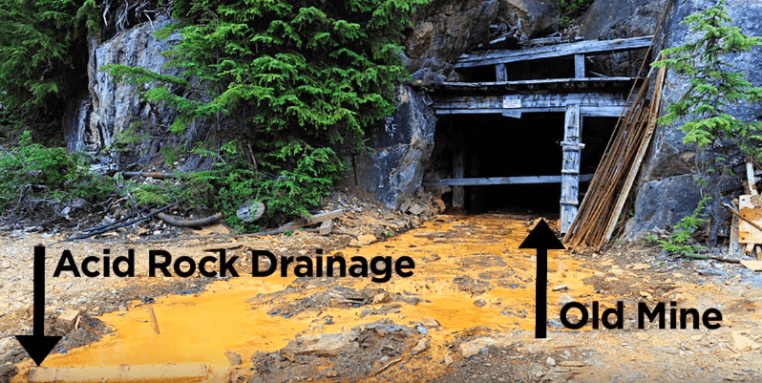
Acid mine drainage is often rust-colored, due to the high iron content.

Slide 16
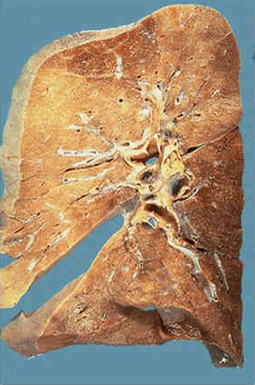
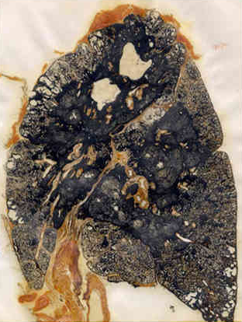
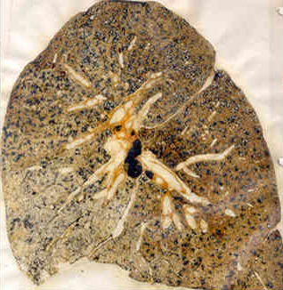
Workers in underground mines are exposed to high amounts of coal dust, which can eventually lead to black lung disease.
Mild case of Black Lung disease.
Severe case of Black Lung disease.
Normal lung tissue.

Slide 17
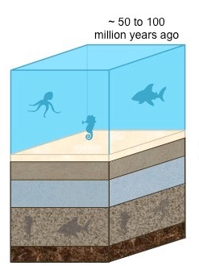
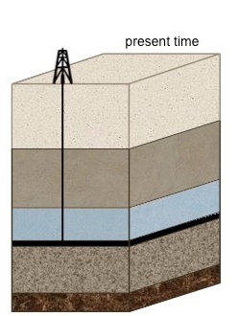
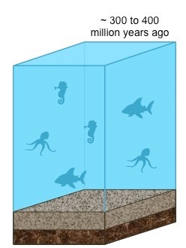
Oil
Like coal, most of the oil on Earth was formed millions of years ago.
Certain warm shallow seas were so ideal for life that organic material was formed faster than it could decompose.
The organic matter was buried, heated, and pressurized, becoming oil.

Slide 18
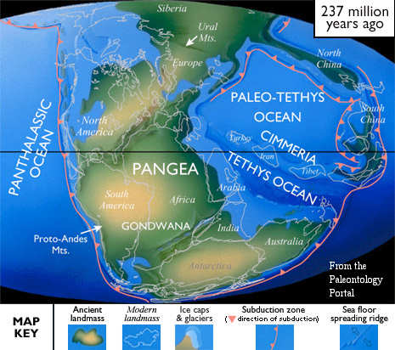
The present day distribution of oil generally lines up with those productive shallow seas.
Middle East, Western U.S. and Canada, Russia

Slide 19
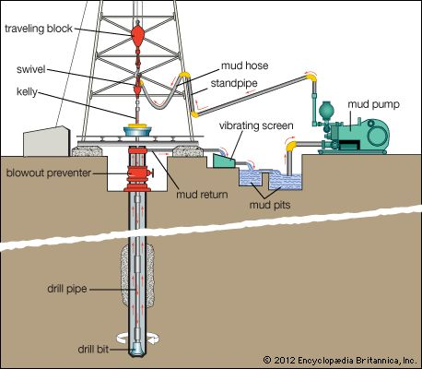
Oil Extraction
As a liquid, oil can be pumped directly out of the ground.
A long drill is used to bore deep into the Earth to reach the deposit.
The hole is lined with a steel pipe and cement.
The top is outfitted with collection pipes and valves.

Slide 20
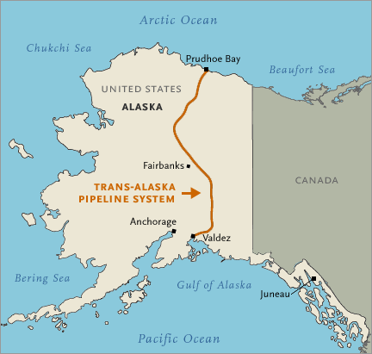
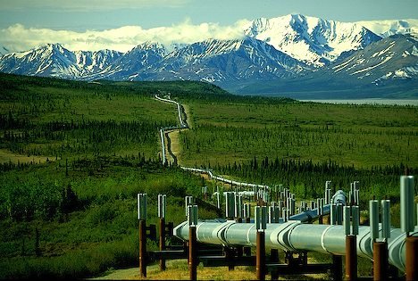
The ease of transporting oil has enabled drilling at very remote locations.
Prudhoe Bay in Alaska, the Gulf of Mexico

Slide 21
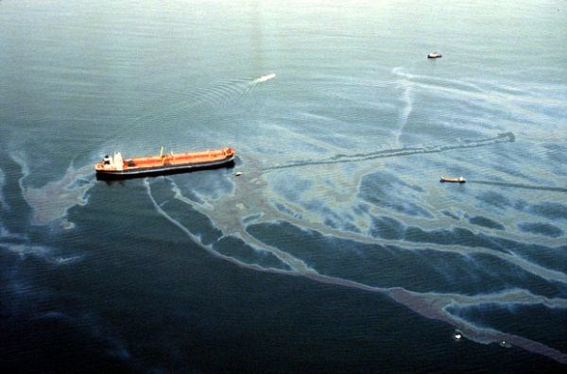
As a liquid, oil can also escape more easily, forming an oil spill.
Oil spills are devastating to marine life.
Penetrates through the fur and feathers of birds and mammals, reducing their ability to fly, float, and insulate themselves.
Benthic organisms, living at the bottom of the sea, can be suffocated.
Directly toxic to fish and plankton.

Slide 22
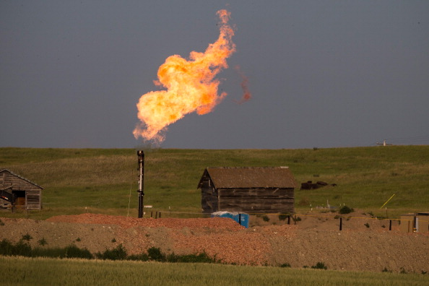
Natural Gas
Natural gas is mostly made of methane, CH4.
As a gas, it is more difficult to extract, contain, and transport.
Many oil drillers will burn off methane deposits instead of collecting them, creating a gas flare.

Slide 23
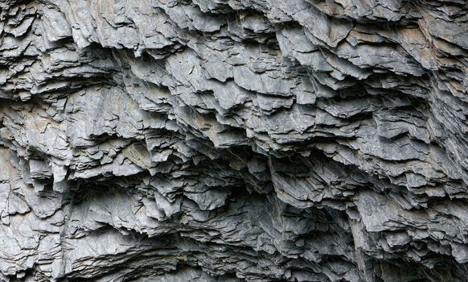
Hydraulic Fracturing
Hydraulic fracturing, or “fracking”, is a controversial technique used to extract natural gas from rock formations that are normally impermeable.
Shale is the most common rock that contains methane.

Slide 24
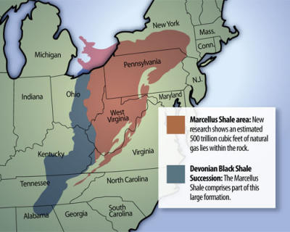
The Marcellus Shale is a large underground shale formation that contains an estimated 88 trillion cubic feet of natural gas.
Prior to 2008, these deposits were unknown.

Slide 25
First, a mixture of water and other chemicals called fracking fluid is pumped into a narrow hole drilled into the rock formation.
The pressure created from this fluid causes the rock formation to fracture.
Sand is injected afterwards to fill the cracks, because it is more permeable and allows the methane to seep out.

Slide 26
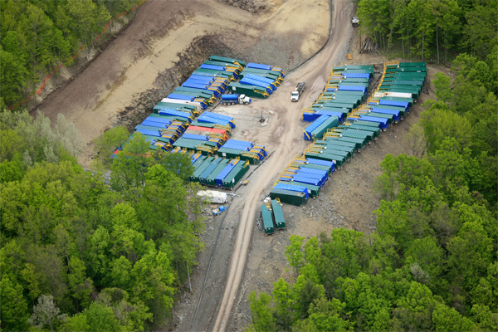
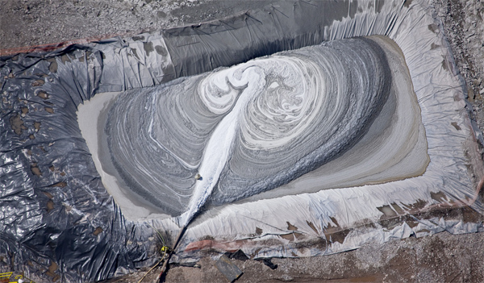
There are two big issues that make hydraulic fracturing controversial.
Millions of gallons of water are needed to “frack” the well.
The water that returns back to the surface, called flowback wastewater, is contaminated with minerals, fracturing fluid chemicals, and natural gas itself.
Water trucking containers, Dimock, Pennsylvania.

Slide 27
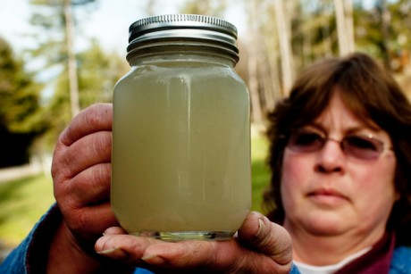
Hydraulic fracturing has been issued many exemptions from Federal environmental laws:
National Environmental Policy Act: Exempted from issuing certain environmental impact reports before drilling.
Clean Air Act: Exempted from emission limits passed in the 1990 amendments.
Clean Water Act: Exempted from pollution from stormwater runoff.
Safe Drinking Water Act: Exempted from a rule restricting underground injection of waste.
Resource Conservation and Recovery Act: Exempted from certain hazardous waste rules.
Water collected from a well in rural Bradford County, Pennsylvania.

Slide 28
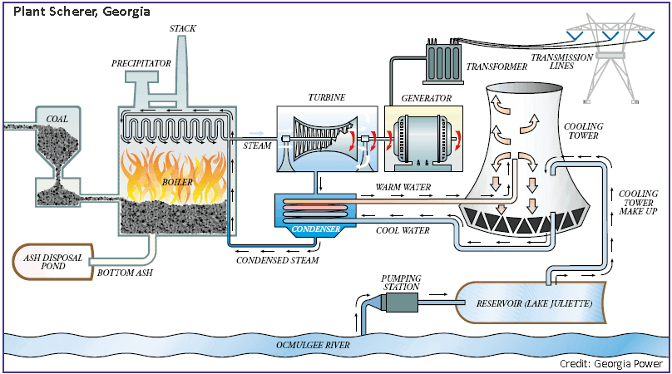
Applications of Fossil Fuels
Coal is primarily used as a source of heat for electricity generation.

Slide 29
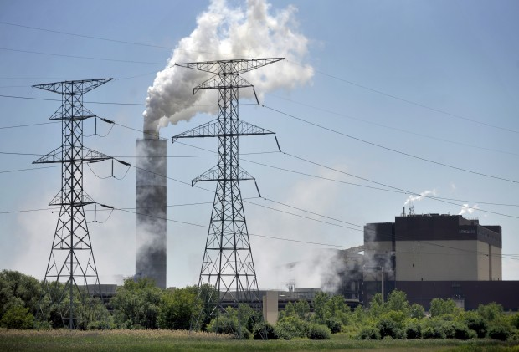
Coal is burned in the boiler.
The chemical potential energy of coal is converted to mechanical kinetic energy of steam.
Pollution is filtered in the precipitator before being released by the smokestack.
Steam generated by boiling water is passed through a series of large fan blades called a turbine.
The kinetic energy of steam is transferred to the spinning blades.

Slide 30
The spinning of the turbine blades spins a generator, which moves a magnet near a charged wire.
The mechanical energy of the turbine is transferred to electrical energy.
The electricity is delivered through a series of large transmission wires.
A cooling tower releases excess heat in the form of steam.

Slide 31
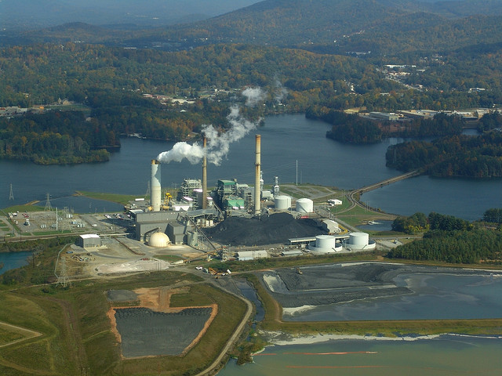
The residual ash is mixed with water to minimize dust, then pumped into an ash storage pond.
The ash is highly toxic, containing heavy metals and other toxins.
Eventually, 70-80% of this ash is disposed of in landfills. The rest is used in concrete, asphalt, and other applications.
Power plant and coal ash ponds, Asheville, North Carolina.

Slide 32
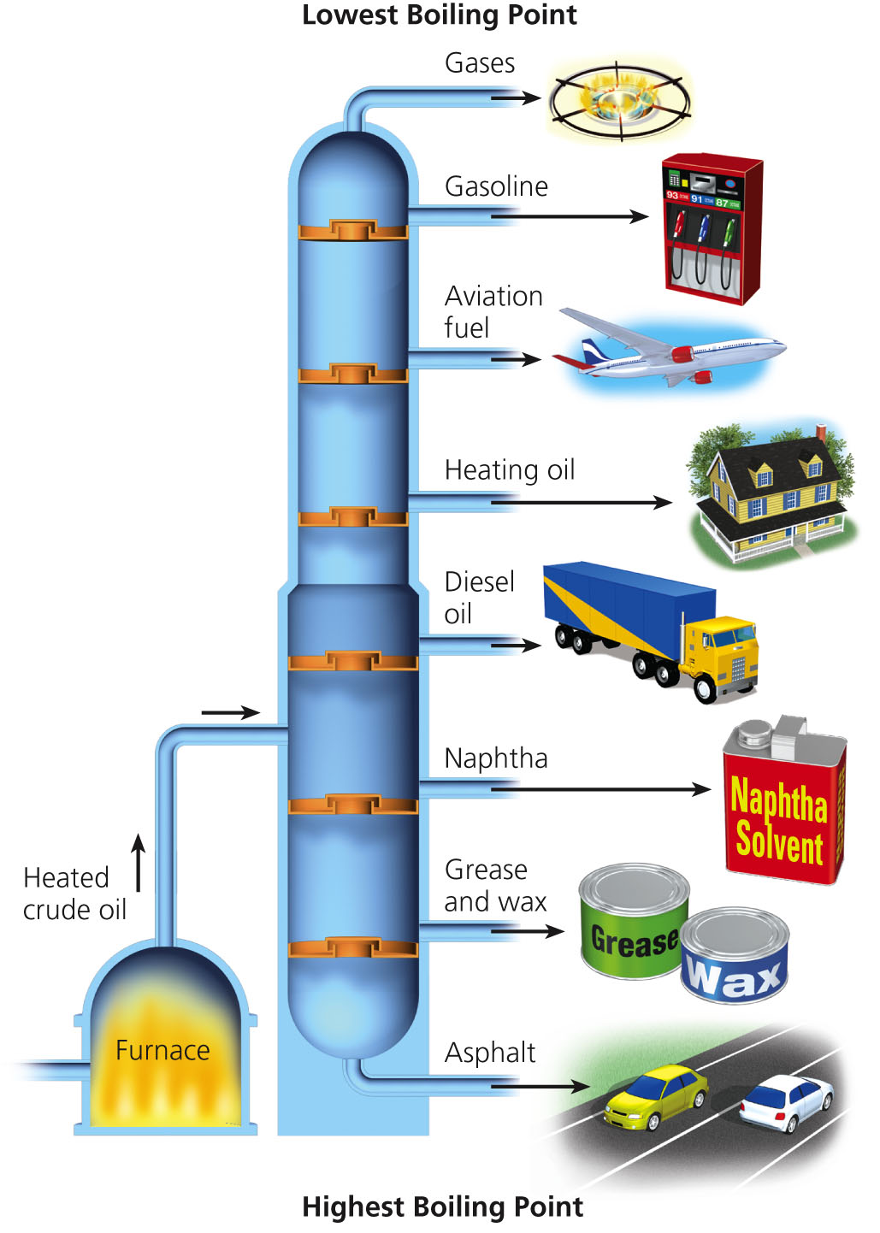
Crude oil is separated in a process called distillation, where it is gradually heated and components are removed based on boiling point.
Low boiling point compounds, like gasoline, are removed first.
The majority of the compounds derived from oil are used for transportation fuel.

Slide 33
Natural gas is either used as a source of household heat or burned for electricity generation.

Slide 34
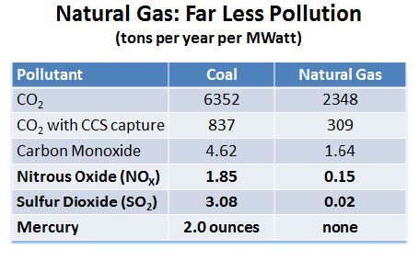
Comparing Fossil Fuels
Each fossil fuel has benefits and drawbacks as an energy source.
In terms of pollution, coal is the dirtiest of the three fossil fuels, with natural gas being the cleanest.

Slide 35
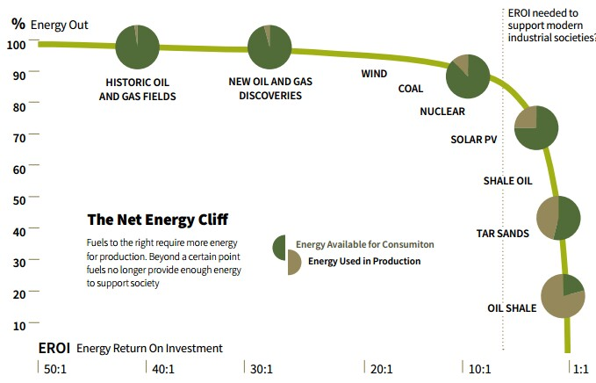
Energy returned on investment (EROI) is a ratio that measures the relative cost and difficulty of extracting a specific resource.
EROI = Energy returned / Energy invested
Lower ratios indicate that the resource is more difficult and expensive to extract.

Slide 36
Current EROI values:
5-9 is considered the minimum EROI for an industrial society to function.
Resource | EROI
Coal | 18
Conventional crude oil | 16
Natural gas | 7
Tar sands oil | 5

Slide 37
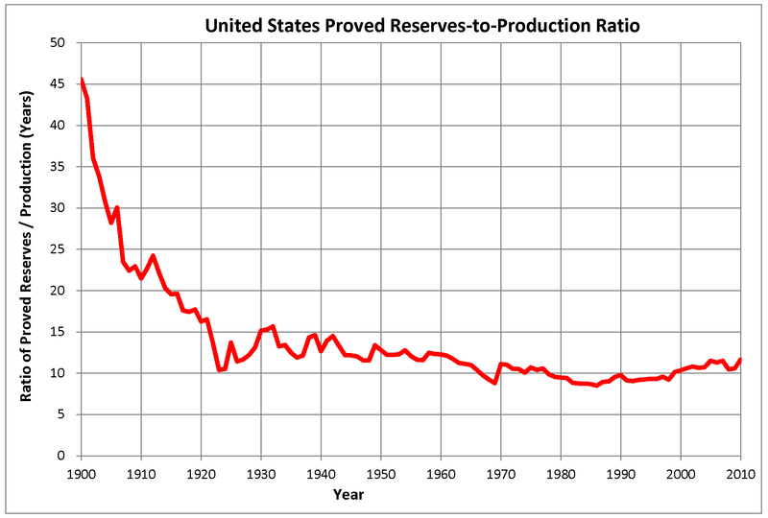
The reserves-to-production ratio estimates how many of a resource we have left at current rates of use.
R/P Ratio = Total remaining reserves / Annual Rate of Production
Current R/P ratios:
Coal = 114 years
Natural gas = 53 years
Oil = 51 years

Slide 38
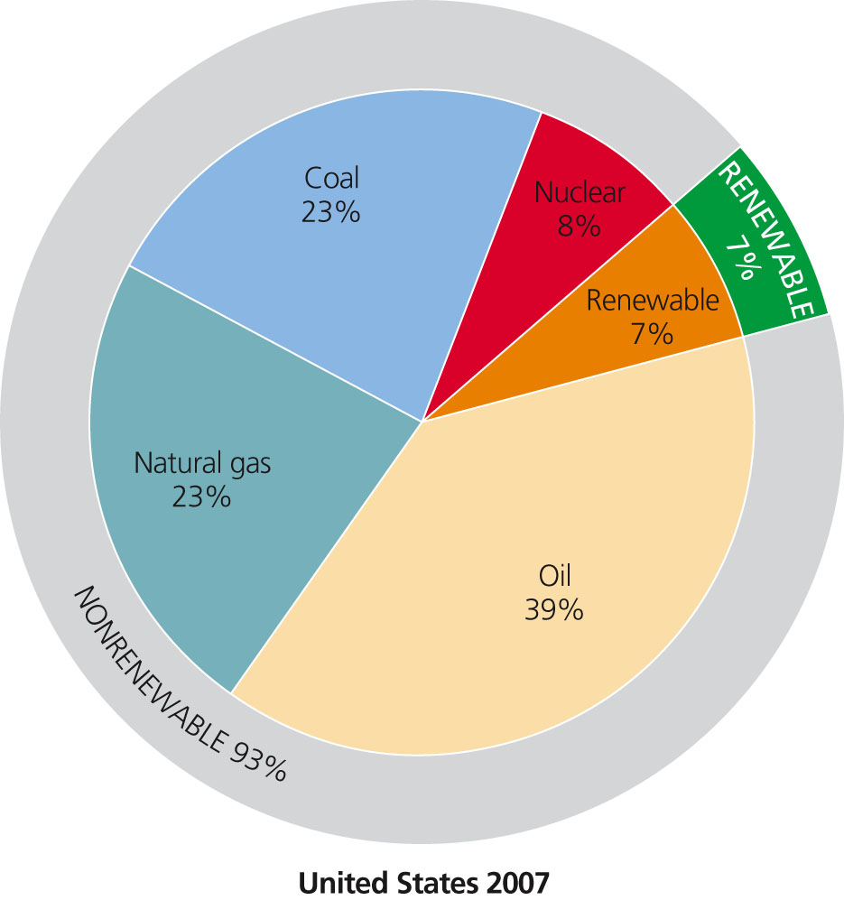
Energy Consumption
Fossil Fuels currently provide about 85% of all commercial energy in the world.
Other renewable sources (wind, solar, hydroelectric) make up 7% of commercial power.
Nuclear power makes up 8% of commercial power.

