Slide 1
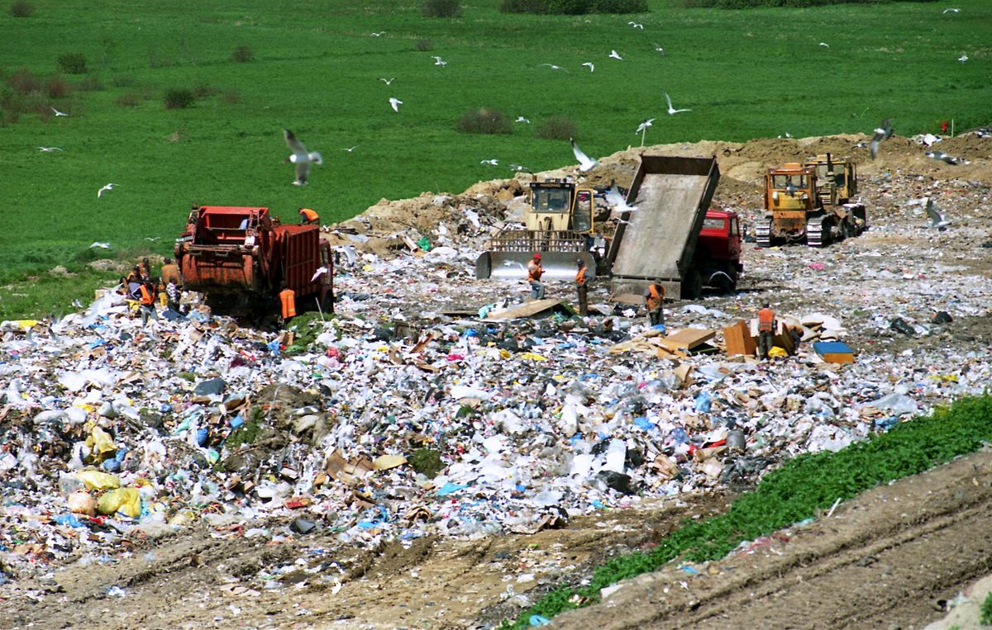
Solid and Hazardous Waste
“There is no ‘waste’ in nature and no ‘away’ to which things can be thrown.”
- Barry Commoner

Slide 2
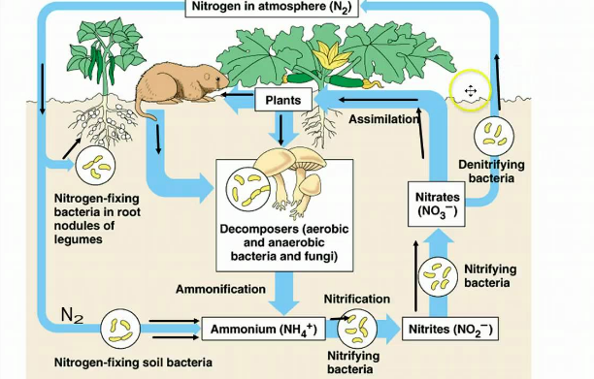
Waste in Natural Systems
According to the Law of Conservation of Mass,
“Matter cannot be created or destroyed, it only changes form.”
Any waste produced within an ecosystem, cycles back through the system.
What happens to waste generated by humans?

Slide 3
The Waste Stream
The total sum of human-generated waste is referred to as the waste stream. This includes:
Municipal solid waste is nonliquid waste that comes from homes, institutions, and small businesses.
Industrial solid waste includes waste from production of consumer goods, mining, agriculture, and petroleum extraction and refining.
Hazardous waste refers to solid or liquid waste that is toxic, chemically reactive, flammable, or corrosive.
Wastewater, used water from sinks, showers, washing machines, toilets, etc.

Slide 4
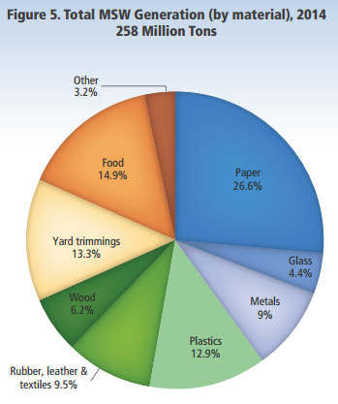
Municipal Solid Waste
According to the EPA, the U.S. produced 258 million tons of municipal solid waste in 2014.
Increase from about 88 million tons in 1960.
Material that can be broken down by naturally occurring decomposers is called biodegradable.
Food scraps, yard trimmings, etc.
Material that is synthetic or not able to be broken down is called non-degradable.
Plastics, glass.
What are our options in dealing with municipal solid waste?

Slide 5
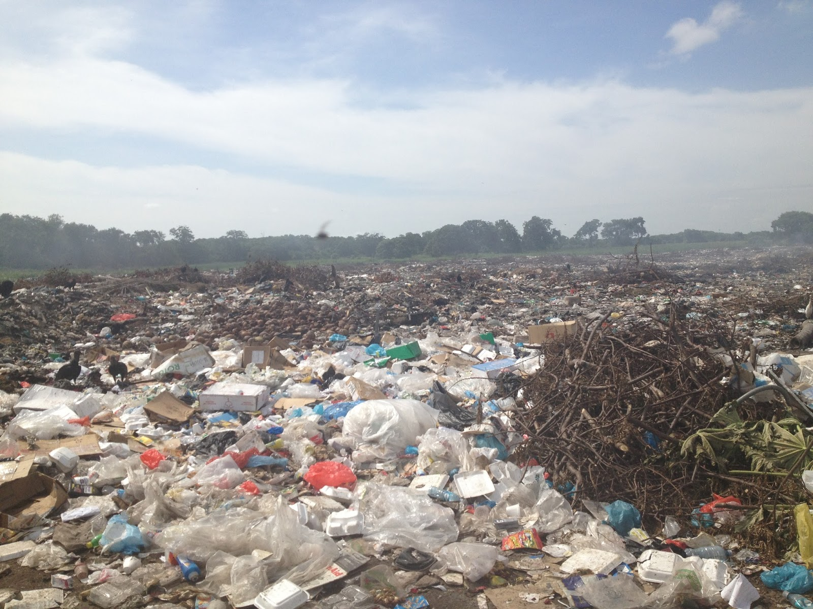
Open Dumps
Open dumps are piles of municipal garbage left in empty lots, pastures, and other exposed places.
Open dumps carry the greatest environmental and human health risks, due to potential contamination of water, soil, and air.
Open dump, Chitré, Panama

Slide 6
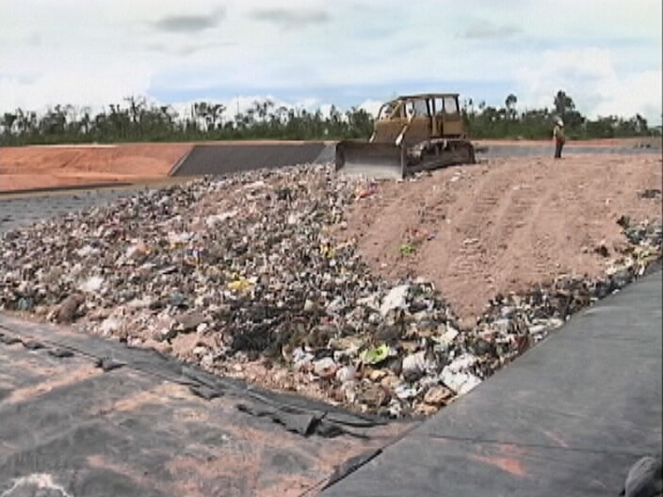
Sanitary Landfills
Sanitary landfills bury waste in the ground or pile it in large mounds engineered to prevent it from contaminating the environment.
Liners and collection systems prevent liquid leachate from escaping into the nearby groundwater.

Slide 7
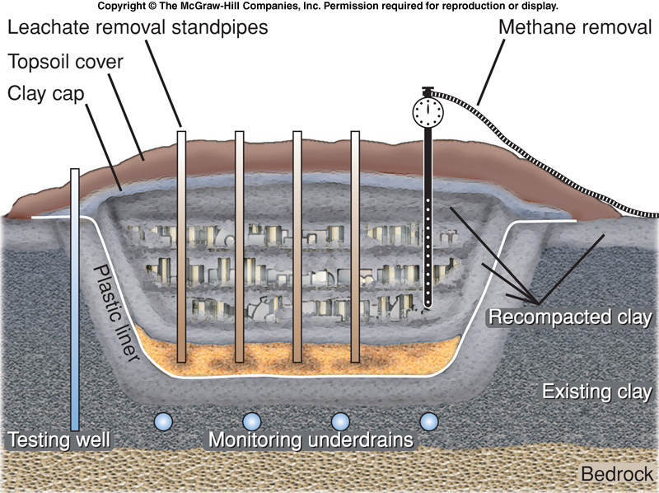
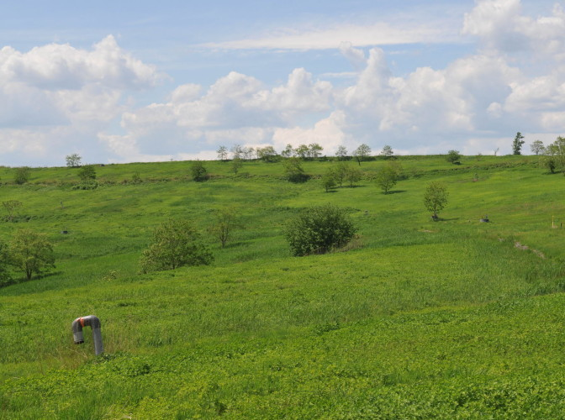
When full, landfills are covered with clay and topsoil, and can be reclaimed for other uses.
Freshkills Park, New York City
Formerly the Freshkills Landfill.

Slide 8
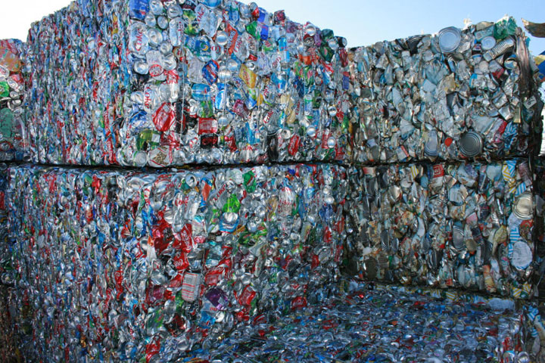
Philadelphia’s Trash Problem
Through the 1950s, Philadelphia relied mostly on landfills to deal with municipal solid waste.
Local landfills eventually reached capacity. Surrounding areas rejected plans for new landfills.
Waste was exported to other states, but this was expensive.
The city began building incinerators as an alternative to deal with the waste.

Slide 9
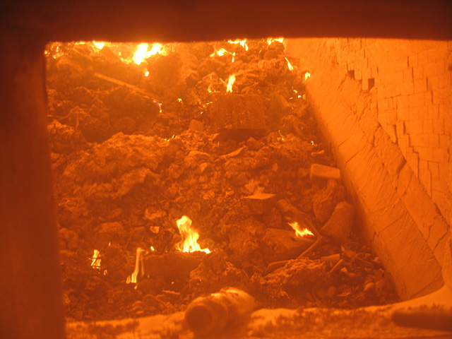
Incineration
Incineration is the burning of municipal solid waste in large furnaces.
Incineration has the advantage of reducing the volume of solid waste by about 70%.
The remaining ash must still be buried in a landfill.
Incinerators are expensive to construct and usually have higher tipping fees than landfills and generate air pollution.

Slide 10
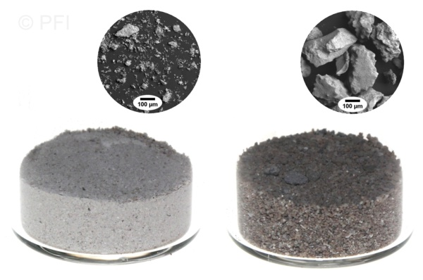
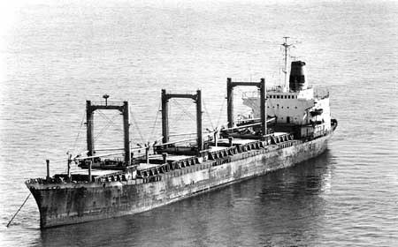
Philadephia began using incineration to reduce waste volume, but leftover ash still needed to be disposed.
Incinerators produce large, heavy particles of bottom ash, and lighter particles of fly ash.
These often contain high concentrations of heavy metals and other toxins.
The city contracted with a private company to haul the ash away on a barge called the Khian Sea.

Slide 11
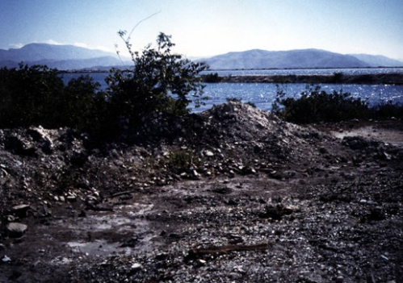
The Voyage of the Khian Sea
The barge was to be dumped on a man-made island owned by the company on the Bahamas, but it was turned away.
Also turned away by the Dominican Republic, Honduras, Panama, and Puerto Rico.
The ship’s cargo was renamed from “incinerator ash” to “general cargo” to “bulk construction material,” and eventually “topsoil fertilizer.”
The Haitian government was persuaded by the crew to accept 4,000 tons of the ash.

Slide 12
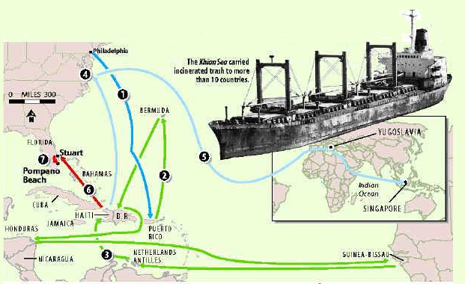
The Voyage of the Khian Sea
The Khian sea made its way across the Atlantic, towards southeast Asia.
The name and registration country of the ship was changed twice.
Unsuccessfully attempted to unload the cargo in Morocco, Yugoslavia, Sri Lanka, and Singapore.
The ship finally returned to the United States across the Indian and Atlantic ocean. By the time it reached port, the ash was gone.

Slide 13
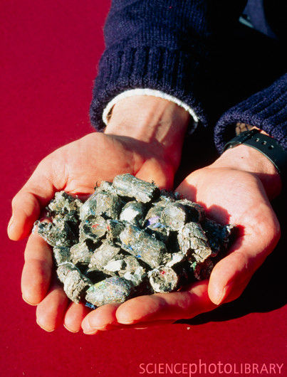
Waste-to-Energy
Modern incinerators are much more efficient.
Recyclable materials are recovered.
The energy released by the incinerators is converted to electricity, a process called waste-to-energy.
Cities may also take some waste and pelletize it and addd it to coal-fired power plants.

Slide 14
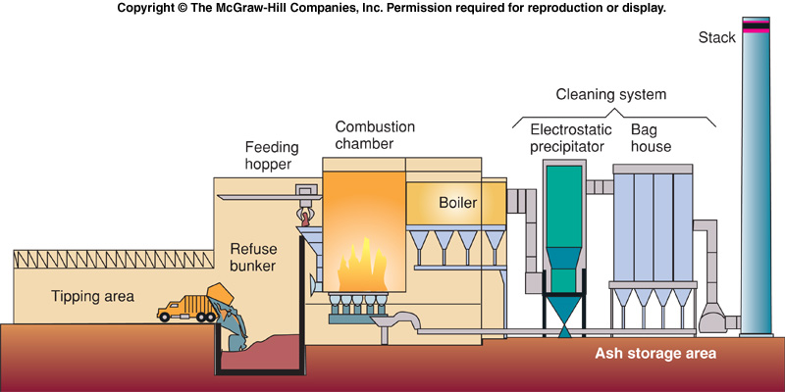
Modern incinerators must collect all of their fly ash and other pollutants through the use of electrostatic precipitators and scrubbers to comply with the Clean Air Act.

Slide 15
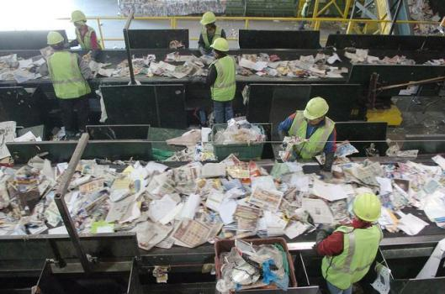
Shrinking the Waste Stream
Recycling is the reprocessing of discarded materials into new, useful products, and it carries many benefits:
Less expensive than producing new raw materials.
Reduces space needed for landfills.
Lowers demand for raw resources.
Reduces energy consumption and air pollution.
Drawbacks include the high costs of sorting the material.
Waste Management recycling plant, Denver, Colorado.

Slide 16
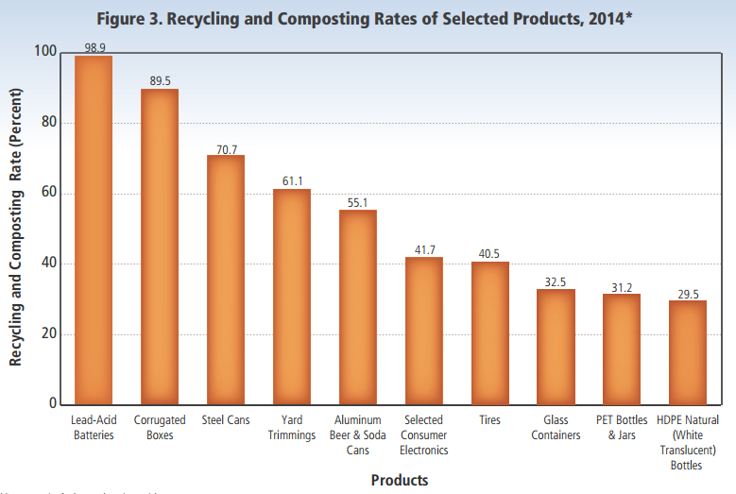
Rates of recycling vary widely for different materials.

Slide 17
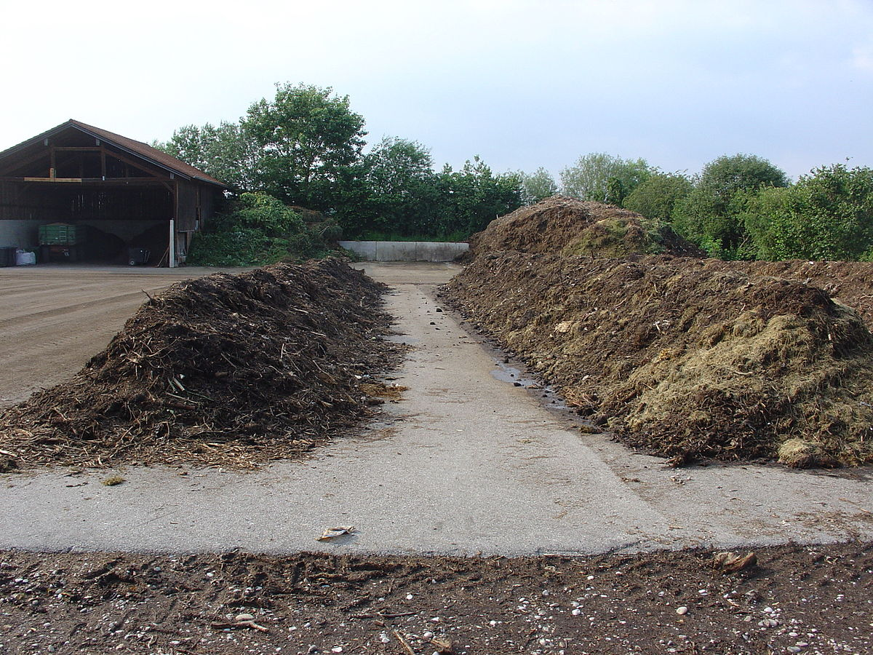
Composting is the biological degradation of organic material under aerobic conditions.
Only works for biodegradable materials.

Slide 18
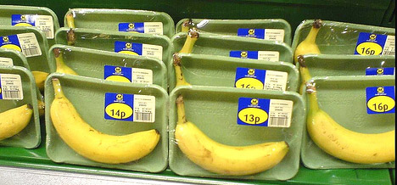
Waste reduction is the cheapest and most effective way to reduce waste is to not produce it at all.
Excess packaging of food and consumer products is one of our greatest sources of unnecessary waste.

Slide 19
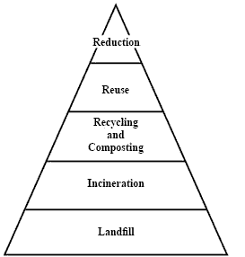
Integrated waste management
Integrated waste management arranges all of the strategies of dealing with MSW in order from top-to-bottom.
By utilizing the top methods first, the amount of material that must be incinerated or buried is minimized.
Some cities achieve this model by having separate collection routes for recycling and food waste.

Slide 20
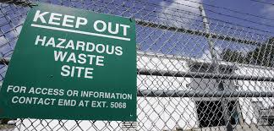
Hazardous and Toxic Waste
EPA estimates U.S. industries generate 265 million metric tons of officially classified hazardous wastes annually.
At least 40 million metric tons of toxic and hazardous wastes are released into the environment each year.
What is hazardous waste?
Hazardous waste site at Camp Lejeune, North Carolina.

Slide 21
Hazardous Waste
Legally, hazardous waste is any discarded liquid or solid that contains substances known to be:
Fatal to humans or laboratory animals in low doses.
Toxic, carcinogenic, mutagenic, or teratogenic to humans or other life-forms.
Ignitable with a flash point less than 60º C.
Corrosive
Explosive or highly reactive.
Hazardous waste disposal did not have any legal requirements for disposal until the Love Canal disaster.

Slide 22
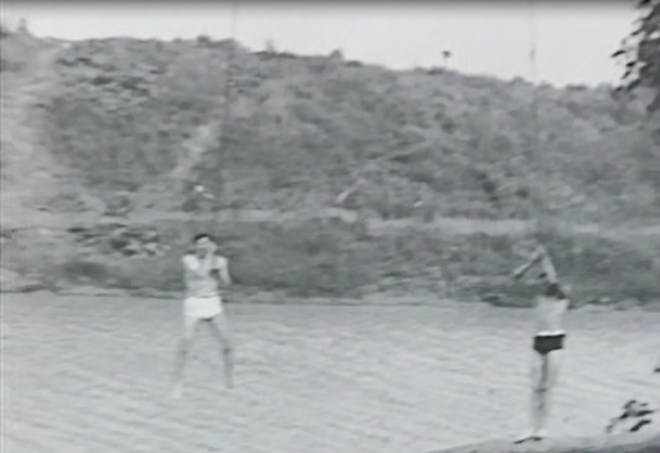
Love Canal
The Love Canal was originally intended to be a “model city” with a shipping lane that bypassed Niagara Falls and provided a source of hydroelectricity.
Planned by entrepreneur William T. Love.
The economic panic of 1893 caused the project to be abandoned after only a single mile was dug.
The abandoned Love Canal became a recreational swimming hole.

Slide 23
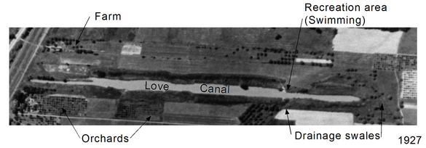
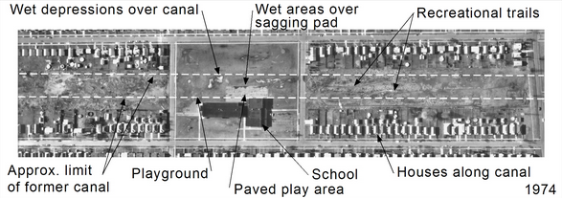
Hooker Chemical bought the land and used the canal as a dumpsite for various hazardous chemicals.
The city of Niagara Falls, desperate for inexpensive land to accommodate a growing population, pressured Hooker Chemical to sell.

Slide 24
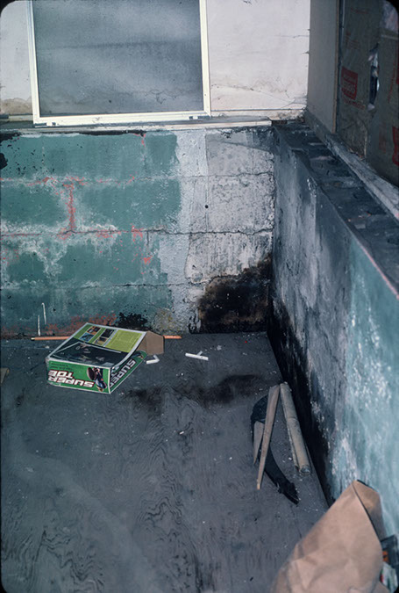
In spite of the warnings, the school district constructed a school immediately adjacent to the canal dump site.
The school playground was constructed immediately on top.
A wet spring caused leachate from the dumpsite to escape, oozing into yards, pavement, and the basements of neighboring homes.

Slide 25
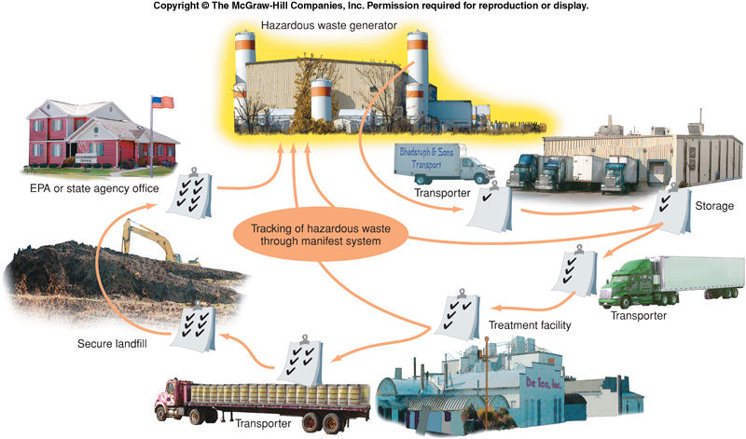
Passage of the RCRA
Following the disaster, the Resource Conservation and Recovery Act (RCRA) of 1976 was passed to provide regulations for the treatment and storage of hazardous waste.
The EPA has “cradle-to-grave” authority over hazardous wastes, meaning they regulate and track their use, storage, treatment, and eventual disposal.

Slide 26
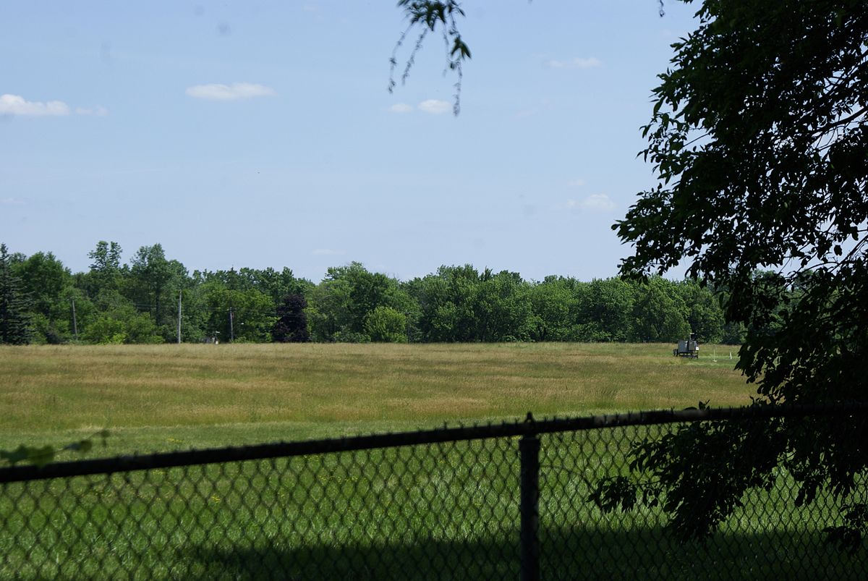
The cleanup at Love Canal also resulted in the passage of the Comprehensive Environmental Response, Compensation and Liability Act (CERCLA), also known as the “Superfund.”
Aimed at rapid containment, cleanup, or remediation of abandoned toxic waste sites.
Anyone associated with a site can be held responsible for the entire clean-up cost.
Love Canal Superfund site, 2012.

Slide 27
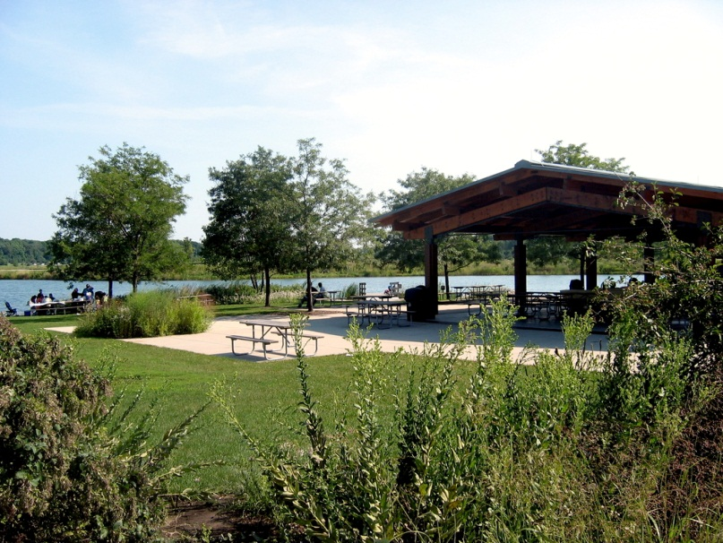
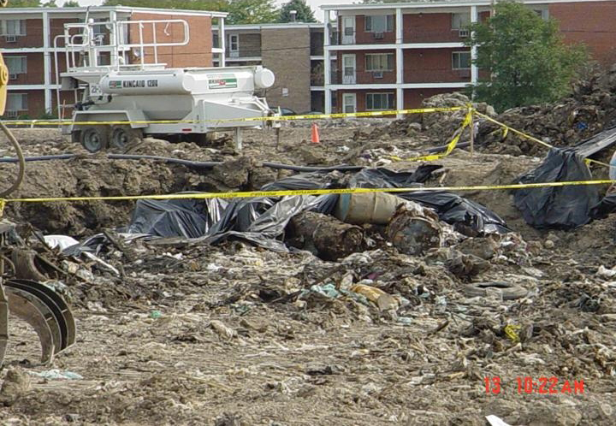
Superfund Sites in Lake County
Petersen Sand and Gravel (Libertyville)
Former quarry, used as a dumping site for paint waste and solvents.
Cleanup completed, redeveloped as Independence Grove
Yeoman Creek Landfill (Waukegan)
Improperly lined landfill was allowing leachate to enter the soil and groundwater.

Slide 28
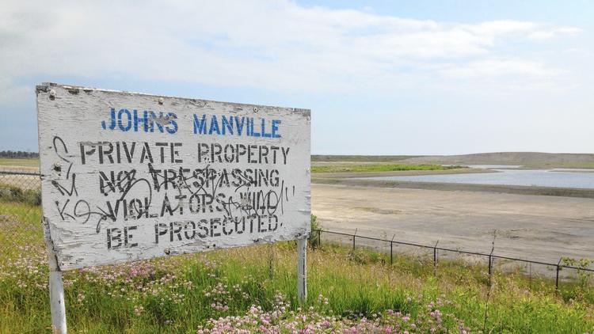
Superfund Sites in Lake County
Johns-Manville Corp. (Waukegan)
Asbestos disposal site at lakefront, just north of the power plant.

Slide 29
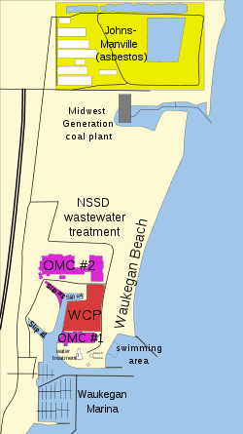
Superfund Sites in Lake County
Waukegan Harbor (Waukegan)
Outboard marine corporation (OMC) sites are contaminated with dumped hydraulic fluid.
Waukegan manufactured gas and coke plant (WCP) is contaminated with several contaminants, including arsenic and PCBs.

Slide 30
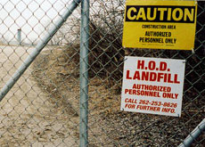
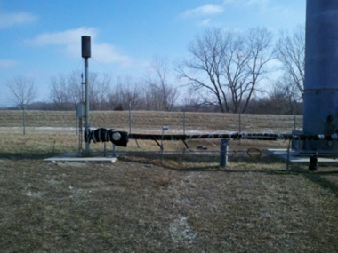
Superfund Sites in Lake County
H.O.D. Landfill
Improperly sealed, vinyl chloride entering groundwater.
Retrofitted with methane collection, used to heat nearby high school.

Slide 31
HAZARDOUS WASTE DISPOSAL
Developed countries often export hazardous waste to developing countries.
An international agreement was passed in 1994 called the Basel Convention that banned the export of hazardous waste.
One of the biggest sources of this exported waste is e-waste, electronic products that have reached the end of their “useful life”.

Slide 32
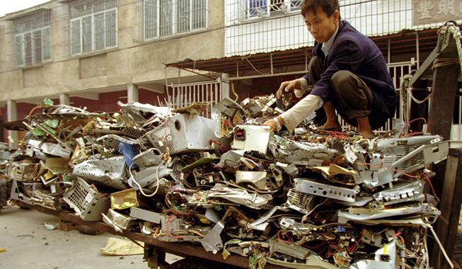
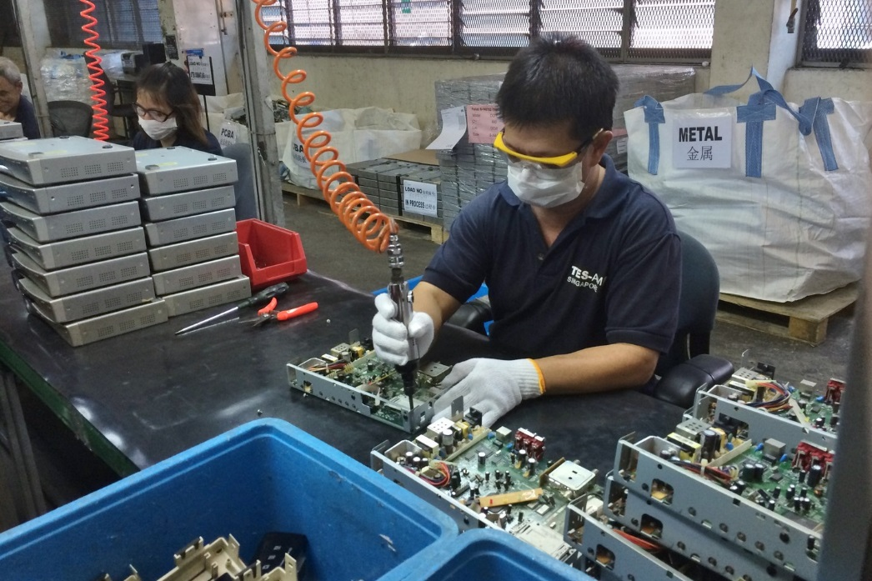
Electronic waste contains multiple heavy metals and other organic toxins.
In developing countries, people will burn and melt down this waste to extract the precious metals.
Many local county and city governments will have electronic waste collection events, to ensure it is not exported and recycled properly.

