Slide 1
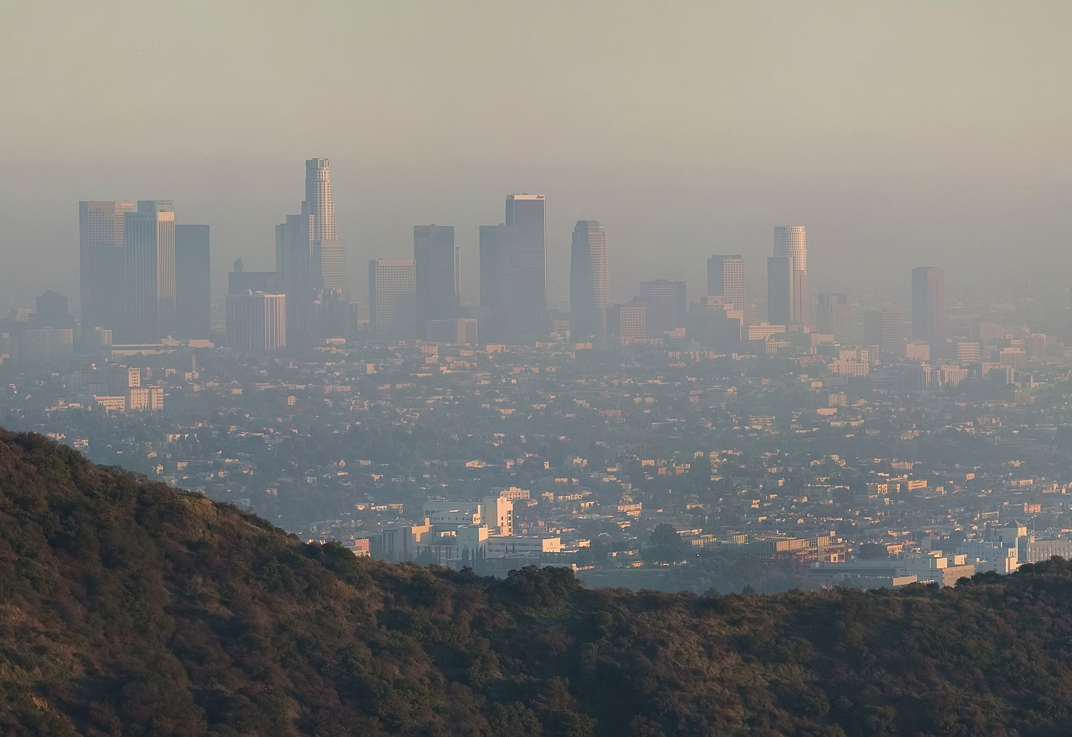
Air Pollution
“You only knew the town was there because there could be no such sulky blotch upon the prospect without a town.”
- Charles Dickens

Slide 2
Air Pollution
Air pollution is the addition of any substance that has harmful or toxic effects to air.
Most air pollution is the result of combustion; a reaction between a fuel source and oxygen that releases energy.

Slide 3
The chemical equation for the combustion of methane (natural gas) looks like this:
In a chemical reaction, the reactants participate in and change as a result of the chemical reaction.
Methane and oxygen
The products are the compounds or elements that are formed as a result of the chemical reaction.
Carbon dioxide and water.
Combustion of a pure fuel releases only carbon dioxide and water. Most of our fuels, however, are not pure.

Slide 4
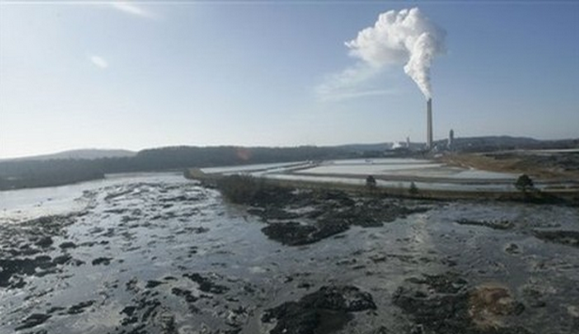
One of the most commonly-used fuels is coal, which contains many impurities which are present in the smoke and ash left behind after combustion.
Arsenic
Mercury
Sulfur
Coal ash holding pond near Kingston, Tennessee.

Slide 5
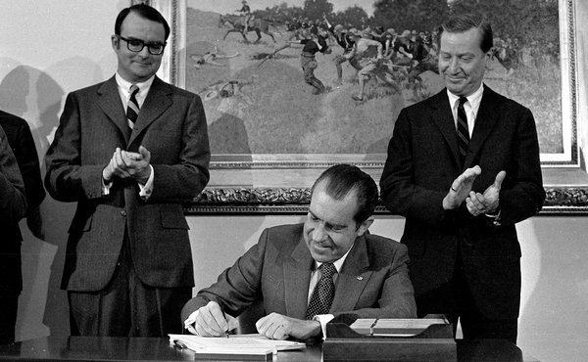
The Clean Air Act
In the early 1970s, the Environmental Protection Agency (EPA) was created in the United States. The first major task of this agency was to enforce the Clean Air Act, a federal law that regulates levels of air pollution produced from all sources: transportation, factories, powerplants, and homes.
This law was the result of public outcry following a series of air pollution disasters.

Slide 6
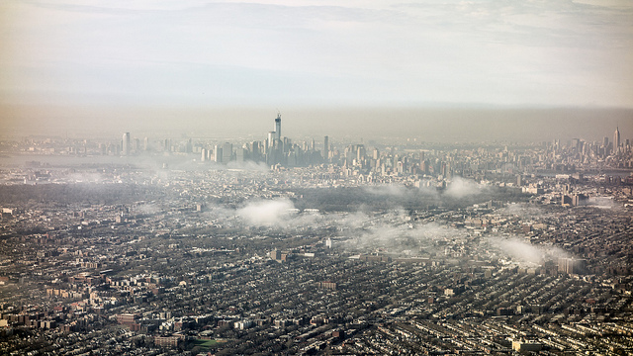
Thermal Inversion
Normally, air becomes cooler as you move higher in the atmosphere.
During a thermal inversion, this pattern switches. A pocket of cool air is trapped below a layer of warmer air.
Thermal Inversion over New York City, March 10, 2013 by Ken McCown on Flickr.

Slide 7
Thermal Inversion Demonstration

Slide 8
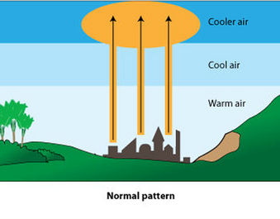
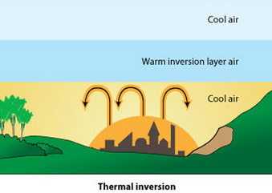
Thermal Inversion
Thermal inversions occur most often in areas with little air movement, such as valleys.
Warm air is less dense than cool air, so under normal circumstances, pollution will rise into the atmosphere and dissipates.
Pollution released into a thermal inversion does not escape.

Slide 9
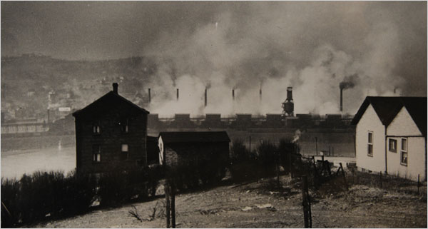
The Donora Fluoride Fog
Donora was a company town near Pittsburgh with two metal processing plants: the U.S. Steel Zinc Works and American Steel & Wire.
Metal smelting plants like these produce a great deal of pollution, as they burn coal to generate sufficient heat to melt and purify their products.
In the days before Halloween in 1948, Donora experienced a 5-day temperature inversion.

Slide 10
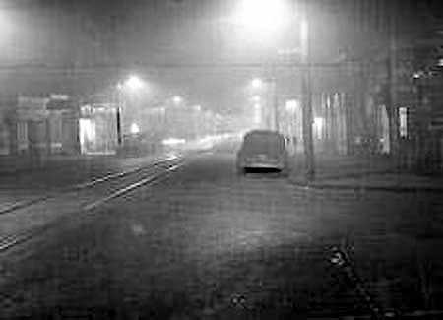
The plants continued operating through most of the inversion, causing the deaths of 20 people, and sickening thousands.
Donora at Noon, Oct 29, 1948

Slide 11
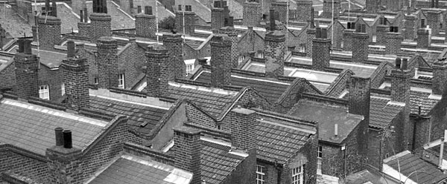
The London Smog
In 1952, an unusually cold winter struck London.
City dwellers were burning high amounts of a low-grade coal that was high in sulfur.
A temperature inversion settled over the city, and emissions from thousands of chimneys began to build up.

Slide 12
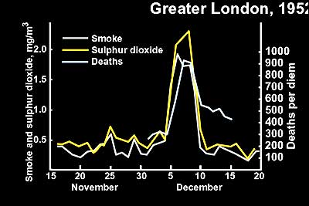
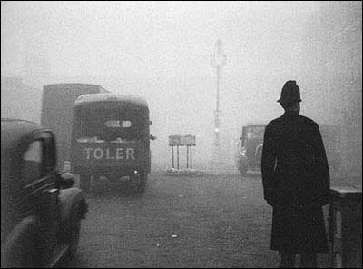
About 4,000 people died during the great smog, with thousands more becoming ill from respiratory tract infections.
Central London, December 1952

Slide 13
Clean Air Act of 1970
The clean air act required the EPA to set and enforce limits for six criteria pollutants, considered to be the most significant to human and environmental health.
Sulfur dioxide (SO2)
Carbon monoxide (CO)
Particulates (PM2.5 and PM10)
Ozone (O3)
Nitrogen oxides (NOx)
Lead (Pb)

Slide 14
Sulfur Dioxide
Sulfur dioxide, SO2, is a colorless gas with a strong “rotten eggs” odor.
Sulfur dioxide is a primary pollutant because its is released directly into the air.
The main source is coal-burning power plants.
Sulfur dioxide also forms secondary pollutants as a result of chemical reactions with the atmosphere.
Sulfur dioxide can react with water vapor to produce sulfuric acid.

Slide 15
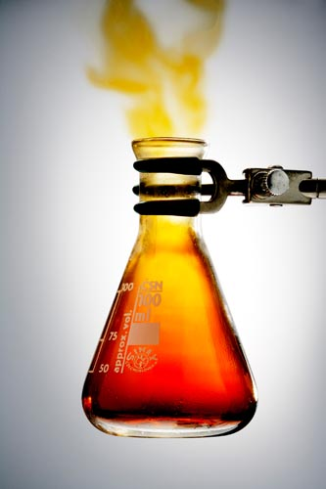
Nitrogen Oxides
Nitrogen oxides, NOx, have a reddish-brown color and a sharp, sweet odor.
The largest source of nitrogen oxide pollution is the use of synthetic nitrogen fertilizer in agriculture.
Also released as part of automobile exhaust.

Slide 16
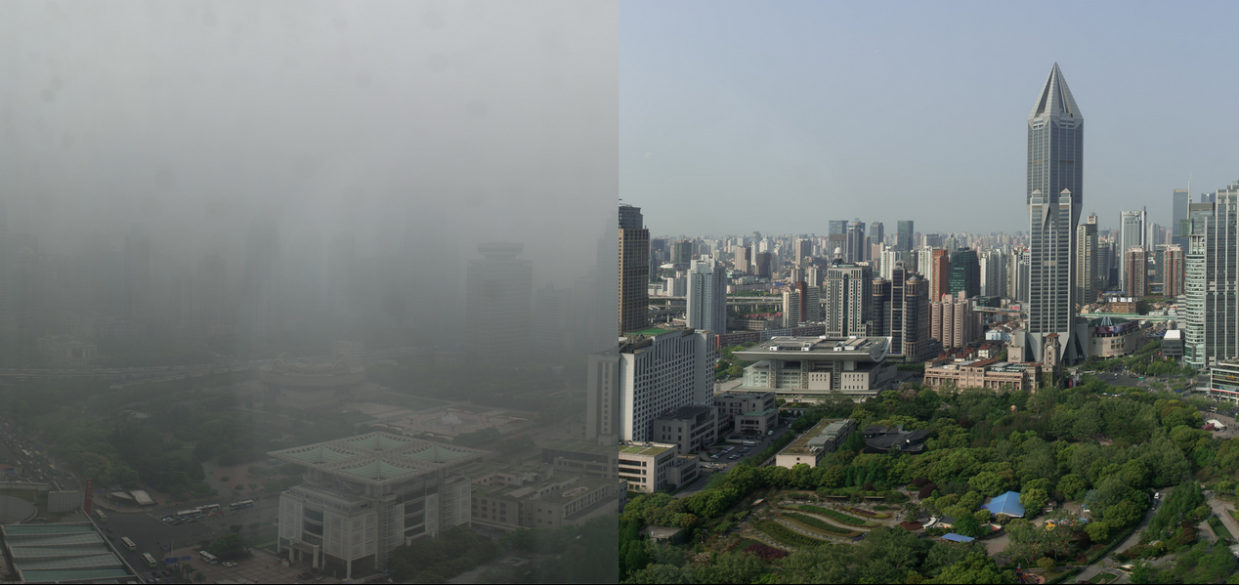
Smog is a mixture of pollutants that form due to a reaction between nitrogen oxide and sunlight.
Shanghai People Square, China. Photo by Morgan Nebel.

Slide 17
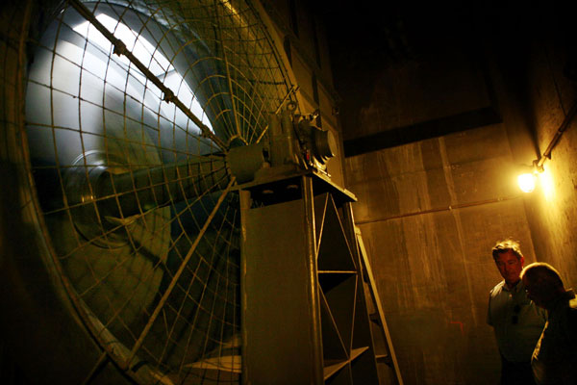
Carbon Monoxide
Carbon monoxide (CO) is a colorless, odorless gas.
The largest source of carbon monoxide is vehicle exhaust.
Carbon monoxide is the most dangerous of the criteria air pollutants, because it directly interferes with the ability of red blood cells to transport oxygen.
One of 84 ventilation fans in the Holland Tunnel, New York City.

Slide 18
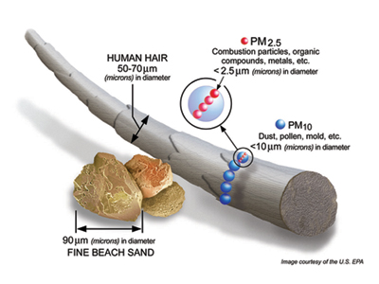
Particulates
Particulates are small, visible particles of dust, ash, soot, or any other visible material.
Particles less than 2.5 microns in diameter are labeled PM2.5
Particles up to 10 microns in diameter are labeled PM10.
In addition to reducing visibility, particulates can be inhaled and embed themselves in lung and brochial tissue.

Slide 19
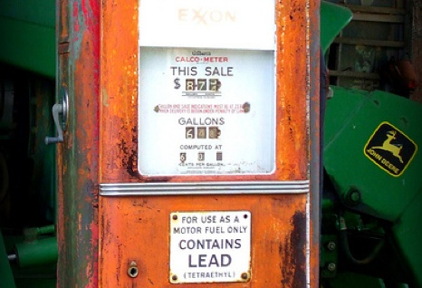
Lead
Lead (Pb) is a heavy metal element.
Known to be a neurotoxin that reduces overall brain function.
Small particles of lead can attach themselves to particulates, which can then be inhaled.
The primary source of lead pollution was automobile exhaust, before leaded gasoline was phased out.

Slide 20
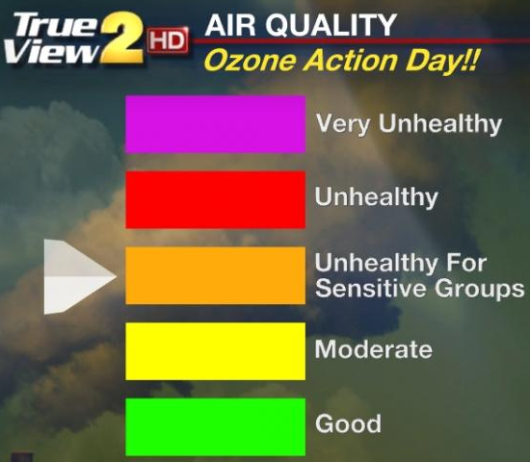
Ground-level Ozone
Ground-level ozone is a toxic secondary pollutant produced as a result of nitrogen oxides and volatile organic compounds reacting to sunlight in the atmosphere.
Volatile organic compounds are released by the evaporation of fuels, solvents, and paints.
Ozone action days are alerts issued when conditions are right for accumulation of the pollutant – usually in the summer.

Slide 21
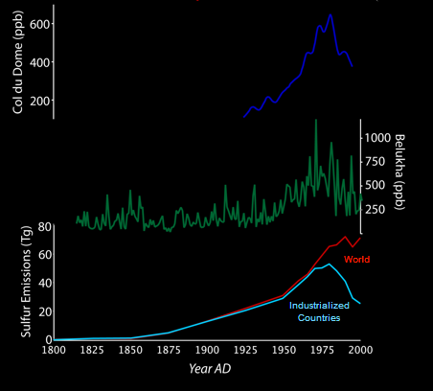
Passage of the Clean Air Act of 1970 had measurable impacts on air quality and health.
Some ice core samples show that sulfur emissions, which increased steadily following the industrial revolution, stabilized in the 1970s.
Studies have shown 4-8 months have been added to the average American’s life span.

Slide 22
Clean Air Act 1990 Amendments
The Clean Air Act was amended in 1990, adding additional standards for pollutants not addressed by the initial law.
Acid Rain
The Ozone Layer

Slide 23
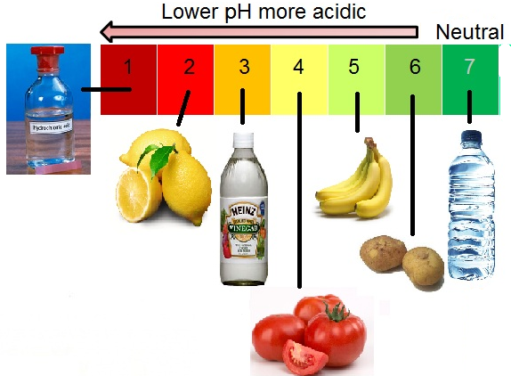
Acid Precipitation
Acid precipitation occurs whenever rainfall or snowfall contains a lower than normal pH due to the formation of two secondary pollutants:
Sulfuric acid, caused by the mixing of sulfur dioxide and water vapor.
Nitric acid, caused by the mixing of nitrogen oxides and water vapor.
Normal rainwater = 5-5.5
Acid rain = 4.0

Slide 24
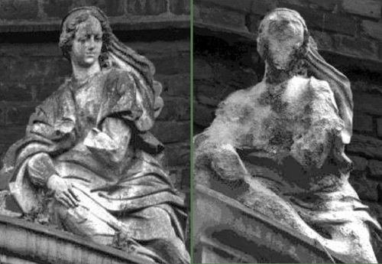
Acid rain has many ecological effects:
Many plants cannot absorb nutrients properly from acidic soil.
Fish and amphibians have specific pH ranges they can tolerate.
Acid rain also has corrosive effects on statues and road structures.
A statue in 1908 and 1969.

Slide 25
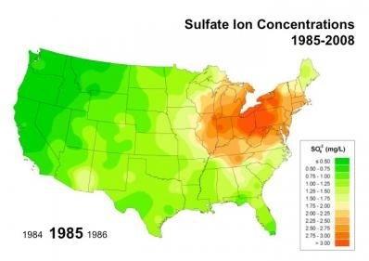
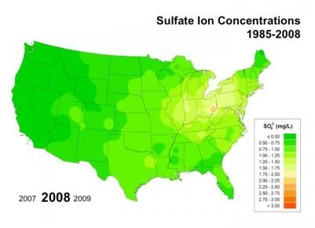
Acid rain has decreased significantly as greater controls have been placed on emitters of sulfur dioxide and nitrogen oxides.

Slide 26
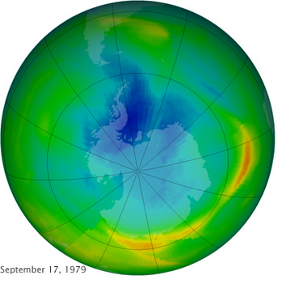
Ozone Layer
While ozone is toxic at ground level, it is an important part of the upper atmosphere.
The ozone layer blocks some of the mutagenic ultraviolet radiation from the sun.
In the 1970s, depletion of ozone above Antarctica was creating a “hole” in this protective layer.
The hole was growing the fastest during September and October each year.

Slide 27
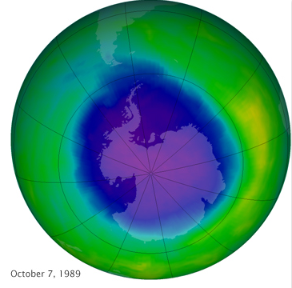
The cause of the hole was discovered to be chlorofluorocarbons (CFCs), compounds that were used in aerosol cans and as refrigerants.
The CFCs were becoming trapped in the Antarctic snow and ice, which would then melt in the spring months of September and October.
An international agreement, called the Montreal Protocol, was passed in 1987.
Phased out chlorine- containing products.

Slide 28
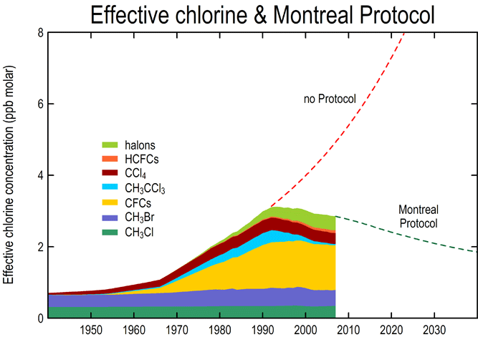
CFC release stabilized and has started to decline.
The ozone hole is predicted to heal sometime around the year 2050.

Slide 29
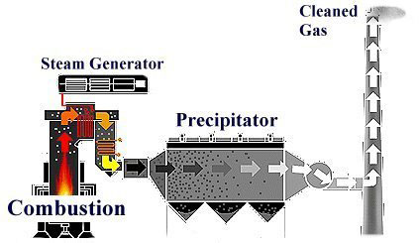
Keeping Air Clean
Scrubber systems use a liquid spray to wash unwanted pollutants from a gas stream.
Electrostatic precipitators are electrically-charged plates that will attract pollutants, preventing them from being released into the air.

Slide 30
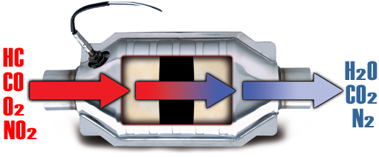
Catalytic converters are devices in cars that reduce emissions of pollutants like nitrogen oxides and carbon monoxide by partially converting them to less harmful gases.

Slide 31
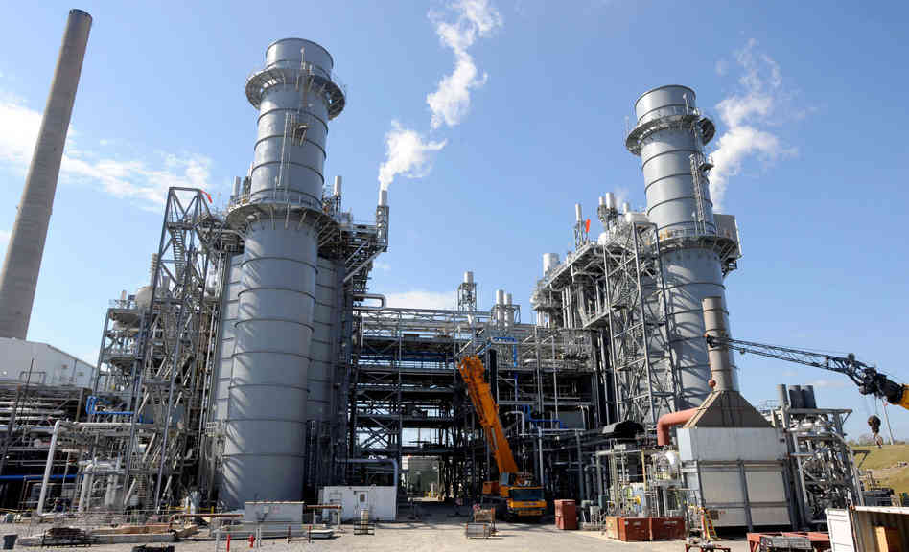
Cleaner Fuels
Switching from fuels that are heavily polluting, like coal, to ones that are cleaner-burning, like natural gas, can also reduce pollution.

